Slide 1
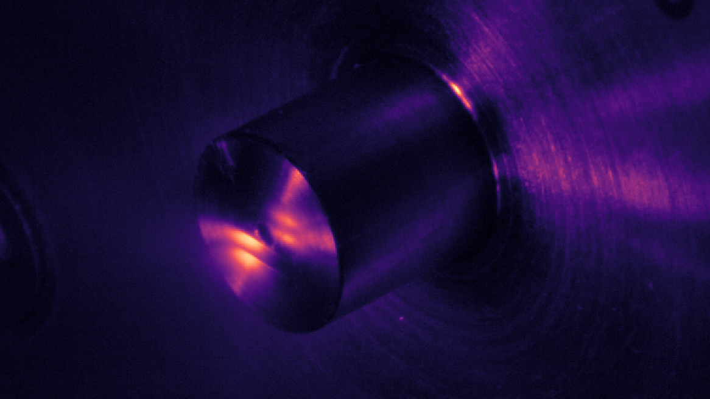
Complex Attosecond Transient-absorption
Spectroscopy
Stephen J. Hageman
Agostini-DiMauro Ultrafast Atomic Physics Research Group
Ph.D. Dissertation Defense
Dec. 8, 2020

Slide 2
Academic History
B.S. Physics and Mathematics, Johns Hopkins University……………………………………………………….................
Entered OSU physics graduate program………………………………………………………….........................................
Completed candidacy exam……………………………………………………………………………………………………………….....
M.S. Physics, OSU…………………………………………………………………………………………………………………………………..
2011
2012
2014
2014
Publication List
Cr:ZnSe mid-IR, multi-mJ, few-cycle amplifier: a new platform for attosecond soft-X-ray physics
V. E. Leshchenko, B. K. Talbert, Y. H. Lai, S. Li, Y. Tang, S. J. Hageman, G. Smith, P. Agostini, L. F. DiMauro, and C. I. Blaga, Optica 7 (8), 981-988 (2020)
High relative-phase precision beam duplicator for mid-infrared femtosecond pulses
A. Camper, H. Park, S. J. Hageman, G. Smith, T. Auguste, P. Agostini, and L. F. DiMauro, Optics Letters, 44 (22), 5465-5468 (2019)
Epitaxial films of Heusler compound Co₂FeAl_{0.5}Si_{0.5} with high crystalline quality grown by off-axis sputtering
B. Peters, A. Alfonsov, C. G. F. Blum, S. J. Hageman, P. M. Woodward, S. Wurmehl, B. Büchner, and F. Y. Yang, Appl. Phys. Lett. 103, 162404 (2013)
Parallel fabrication of magnetic tunnel junction nanopillars by nanosphere lithography
W. G. Wang, A. Pearse, M. Li, S. Hageman, A. X. Chen, F. Q. Zhu, and C. L. Chien, Scientific Report 3, 1948 (2013)
Electric-field-assisted switching in magnetic tunnel junctions
W. G. Wang, M. Li, S. Hageman, and C. L. Chien, Nature Mater. 11, 64 (2012)
Thermal annealing study of magnetoresistance and perpendicular anisotropy in magnetic tunnel junctions based on MgO and CoFeB
W. G. Wang, S. Hageman, M. Li, S. X. Huang, X. M. Kou, X. Fan, J. Q. Xiao, and C. L. Chien, Appl. Phys. Lett. 99, 102502 (2011)

Slide 3
Outline
Introduction: Attosecond transient-absorption spectroscpy
Experimental Apparatus: Transient absorption beamline (TABLe)
Experimental Investigations
Two-source High Harmonic Generation using a square-wave phase grating (SWPG)
Measurement of Refractive Index using a SWPG
Attosecond Transient-absorption spectroscopy of argon Fano resonances
Complex Attosecond Transient-absorption Spectroscopy

Slide 4
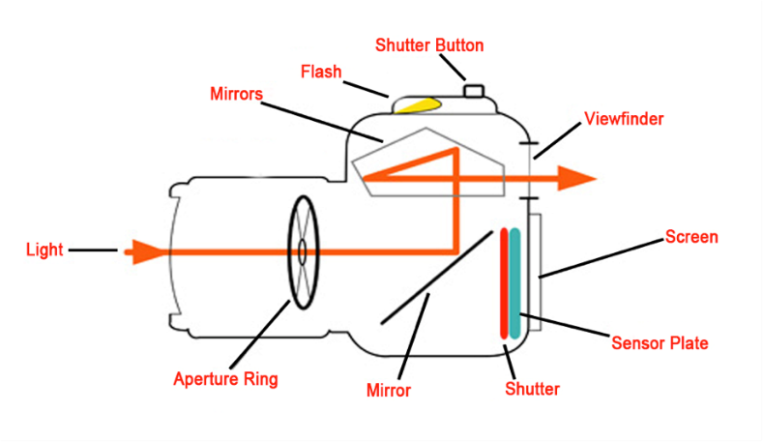
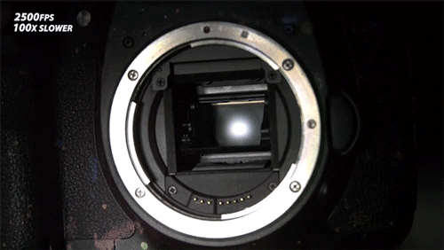
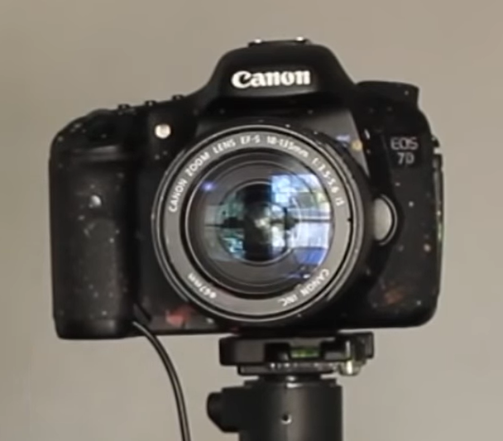
Introduction: measuring fast events
How can you study the shutter mechanism of a DSLR camera, using a DSLR?
What shutter speed would you need?
Your shutter speed needs to be faster than what you want to study!

Slide 5
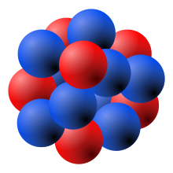
Introduction: measuring fast events
How about motion of electrons in an atom?
Electron orbits hydrogen nucleus 6.67 x 10¹⁵ times per second, every 150 as (10⁻¹⁸ s)
To see this, you would need a “shutter” speed faster that 1/150 as⁻¹
This can be done using lasers!

Slide 6
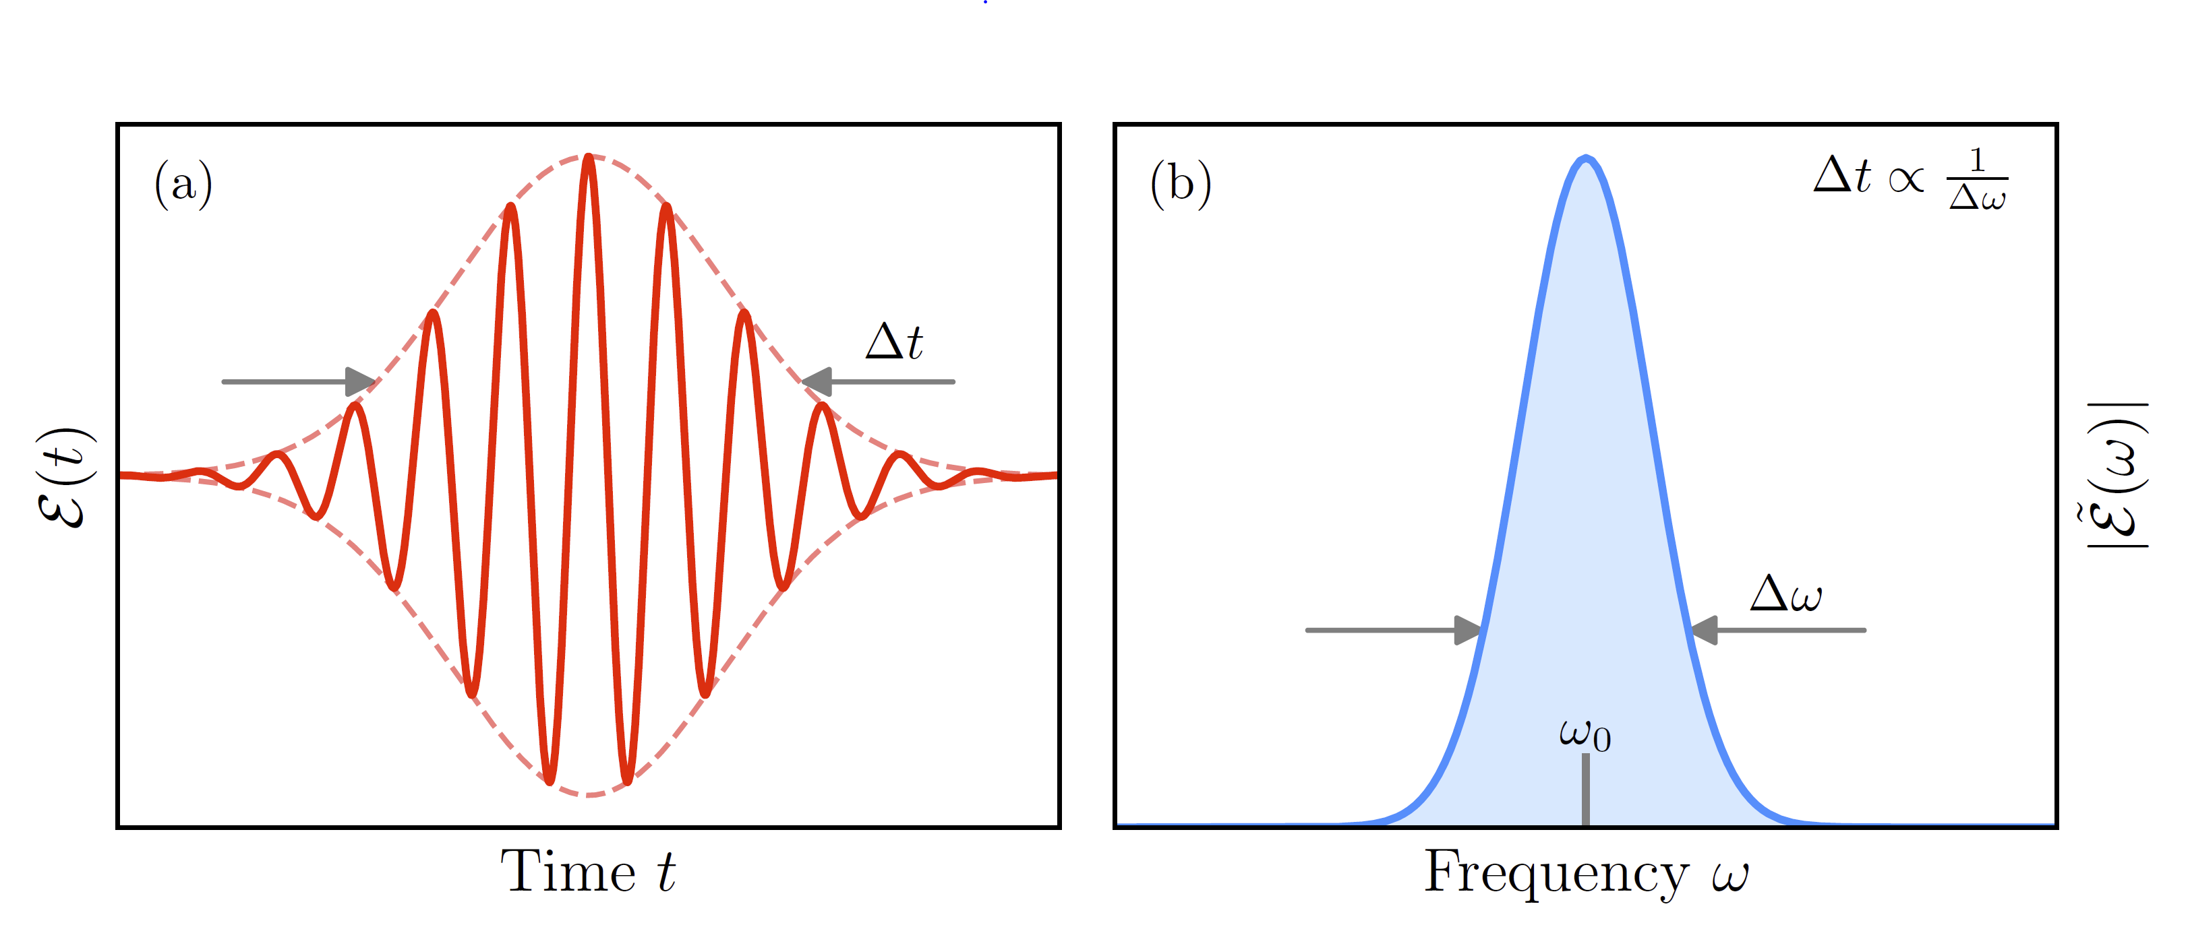
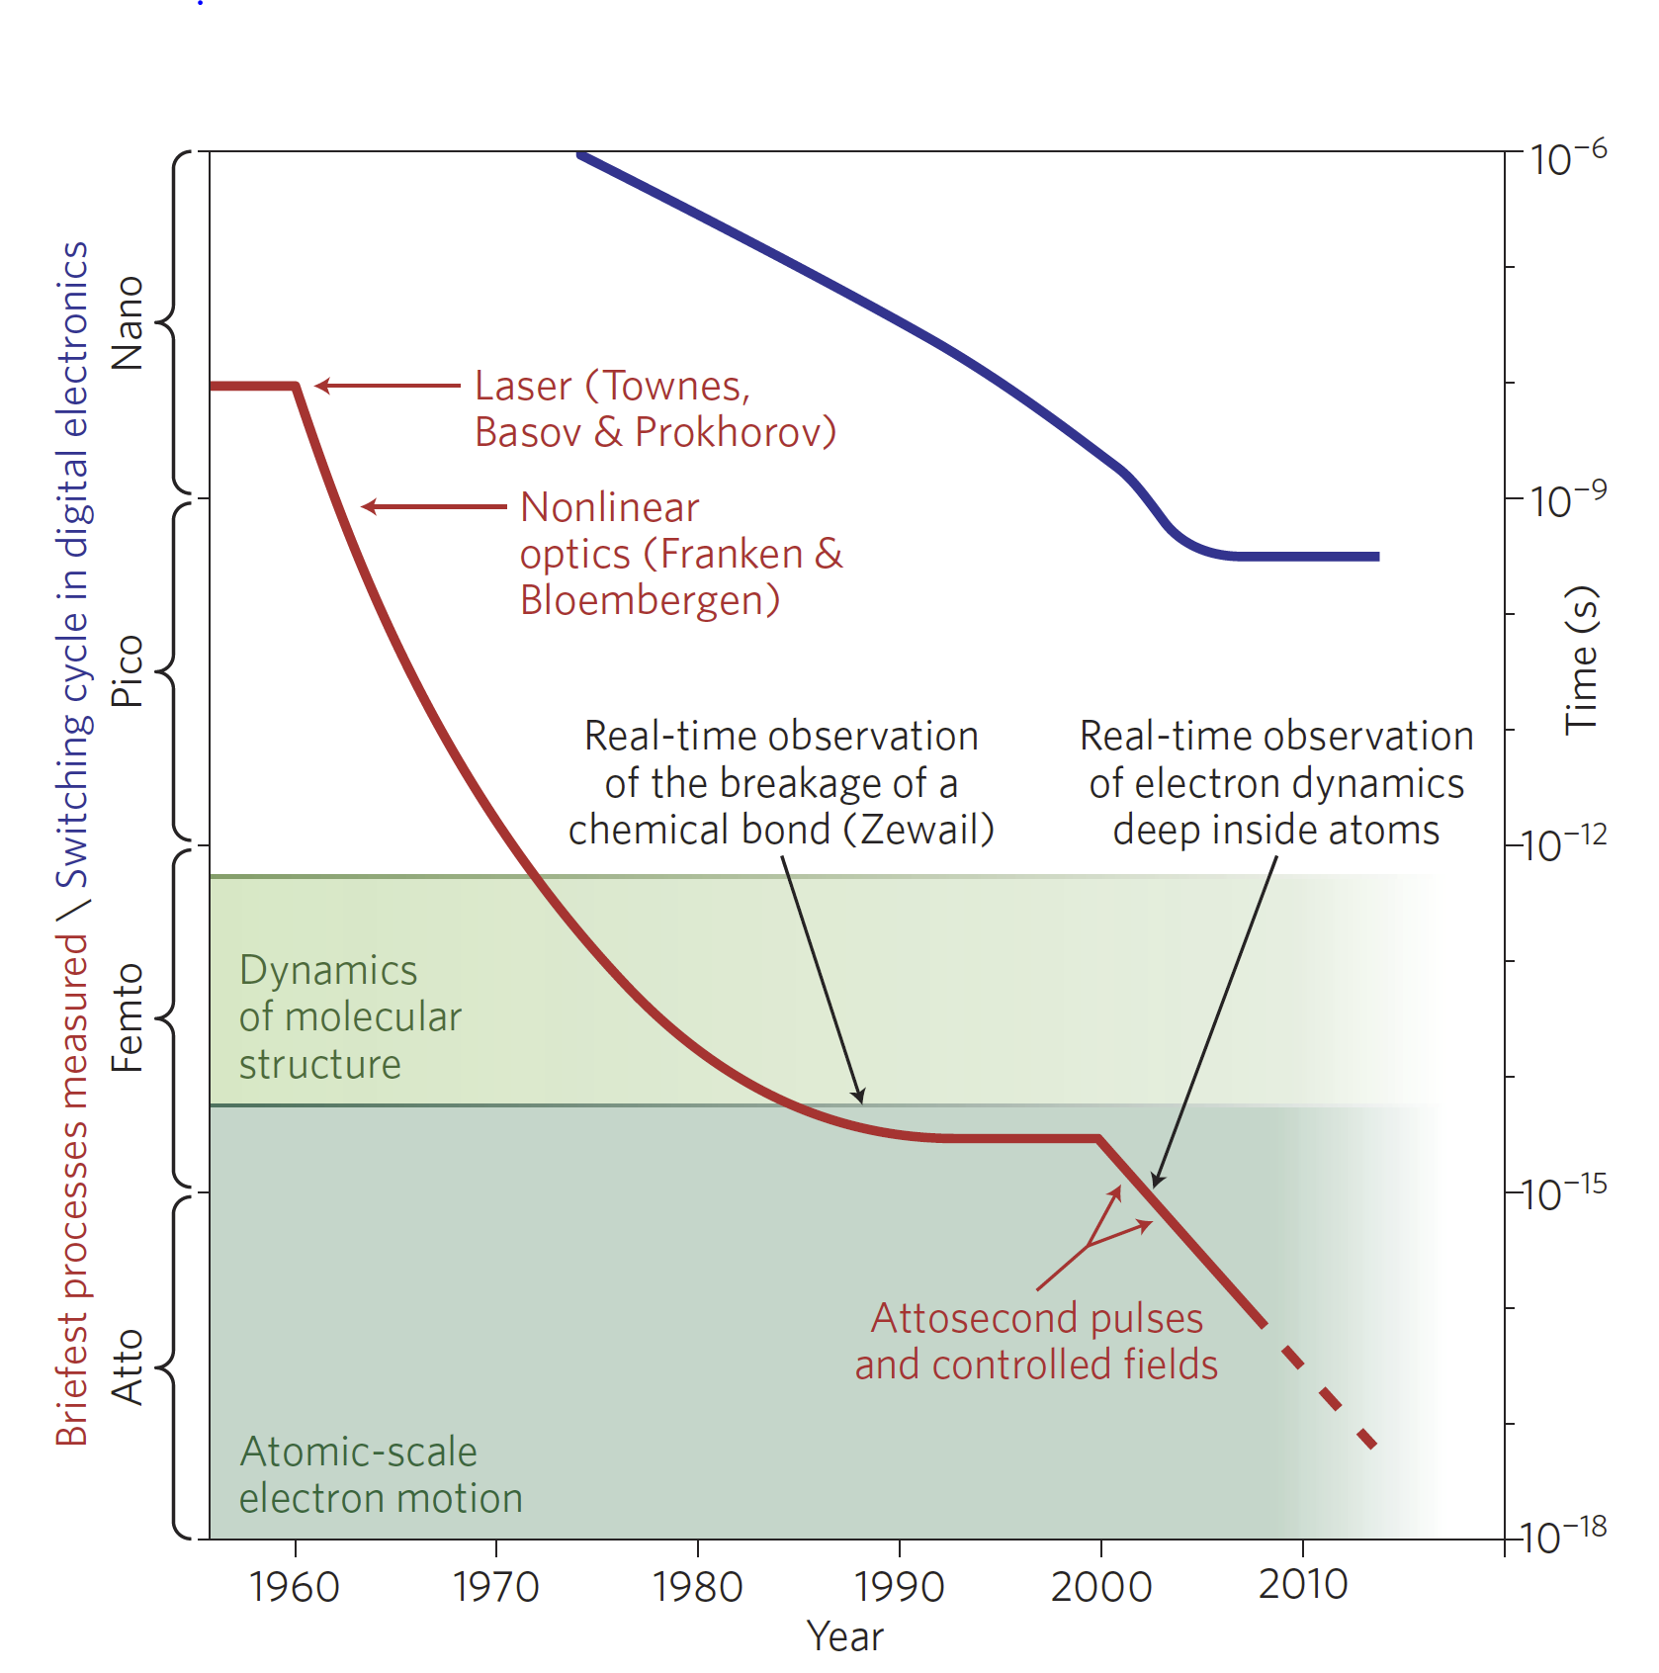
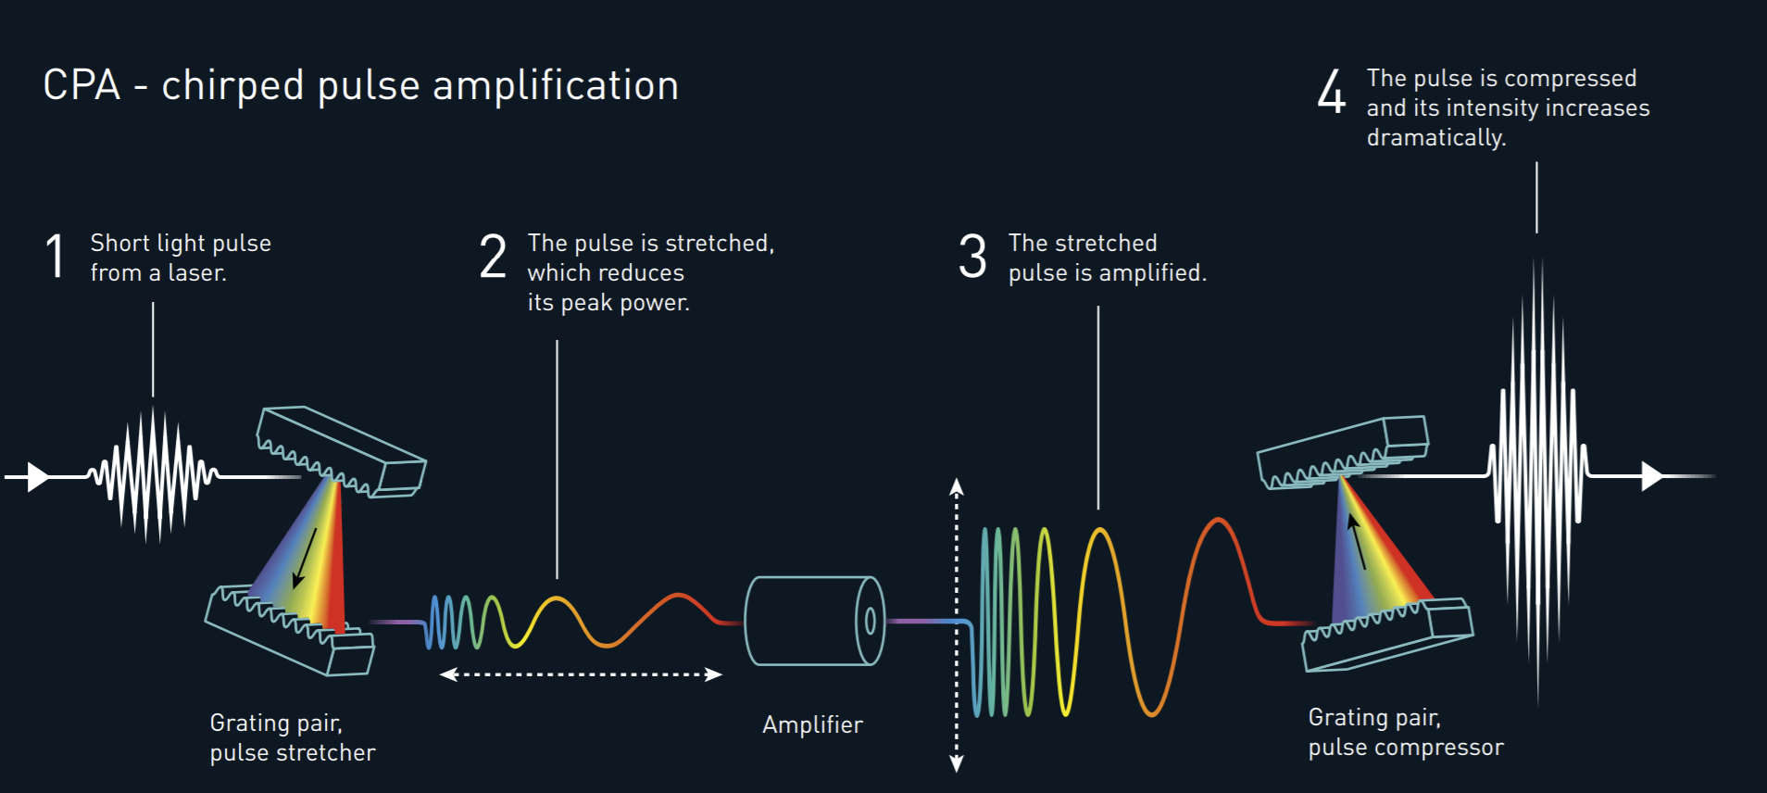
Ultrashort Laser Pulses
Ultrashort laser pulses are characterized by their pulse duration Δt and bandwidth Δω
Great effort has been made to reduce the pulse duration, enabling new observations
Modern CPA laser systems can directly produce laser pulses that have a pulse duration as small as a few femtoseconds (10⁻¹⁵ s)
To get beyond this, high-harmonic generation can be used to generate attosecond pulses

Slide 7
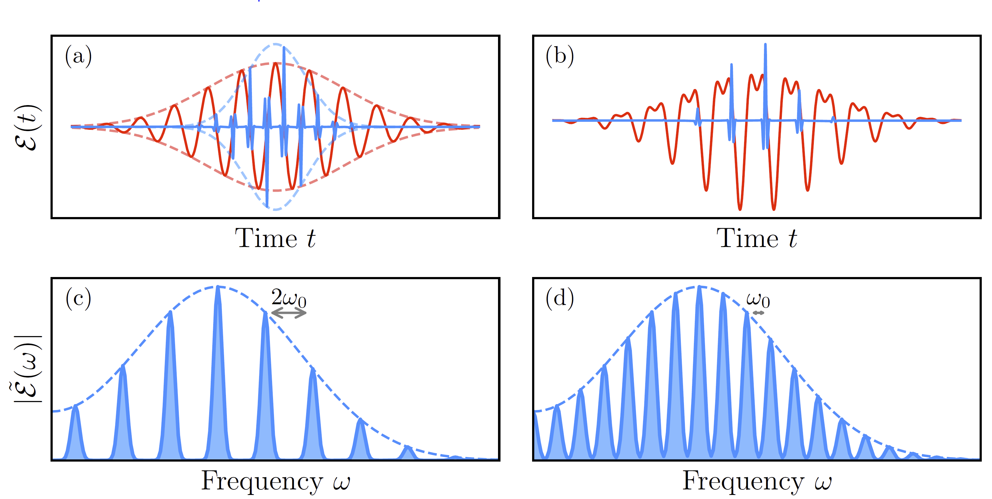
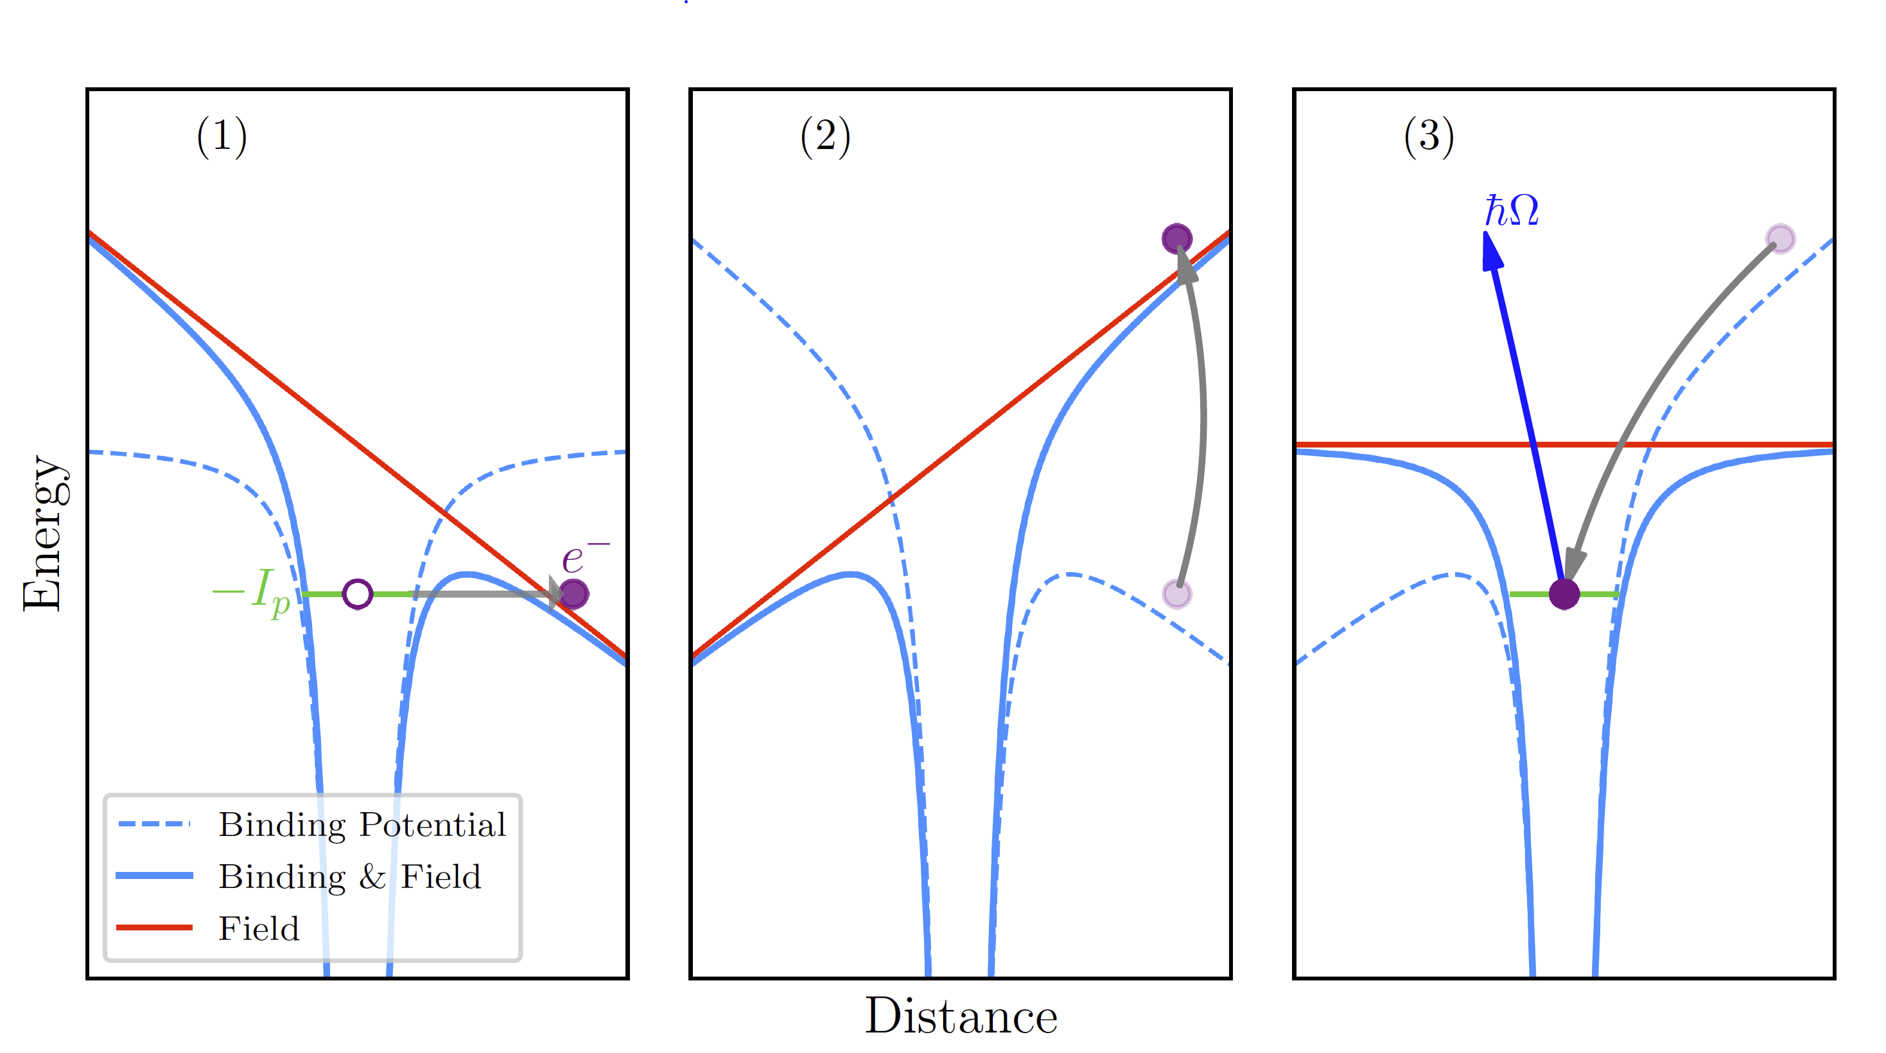
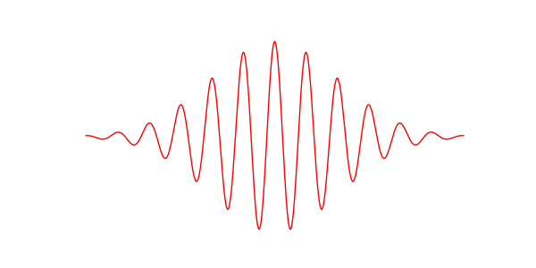
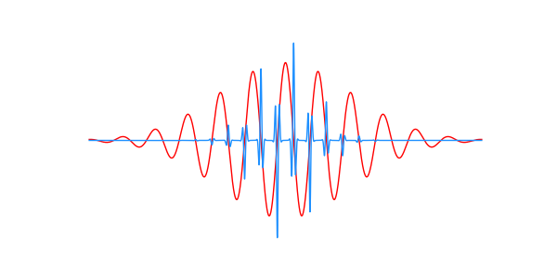
Introduction to high-harmonic generation (HHG)
Ionization
Propagation
Recombination
HHG can be used to generate pulses with bandwidth in the XUV (up to hundreds of eV)
Describe by a 3-step model
Naturally produces an attosecond pulse train (APT)
Characterized by odd harmonics of the fundamental in the frequency domain
Gas
IR
XUV

Slide 8

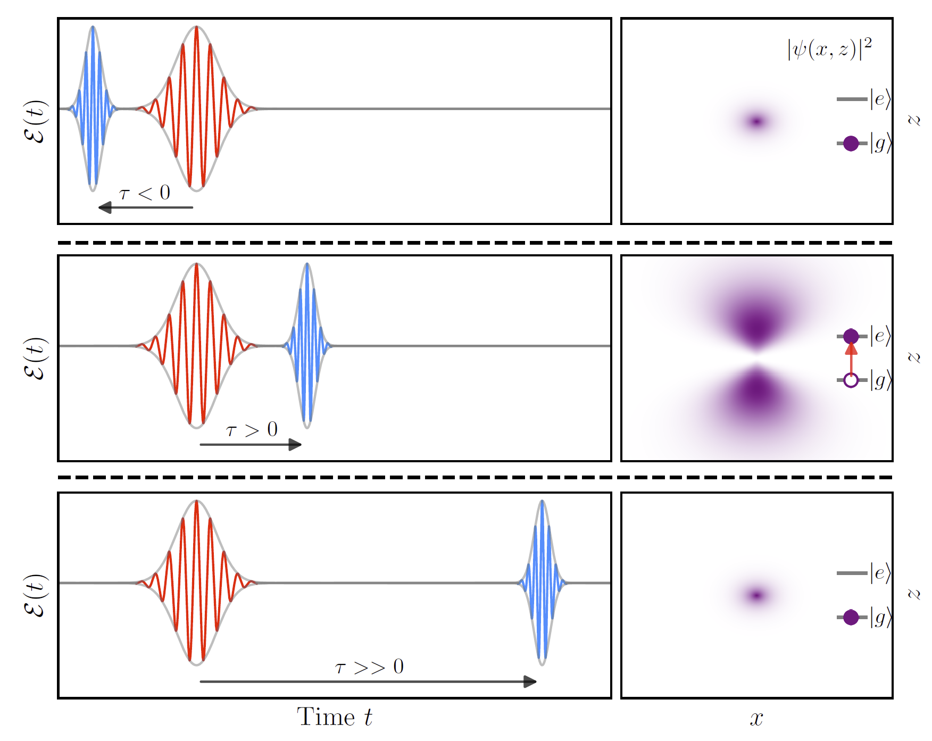
Introduction to pump-probe techniques
Can be used to extract dynamics of a system in a pump-probe experiment
Pump pulse is used to modify the system of interest → Probe pulse follows at a variable time delay
XUV APT generally serves as the probe, and the pump is a replica of the pulse used to generate the APT

Slide 9
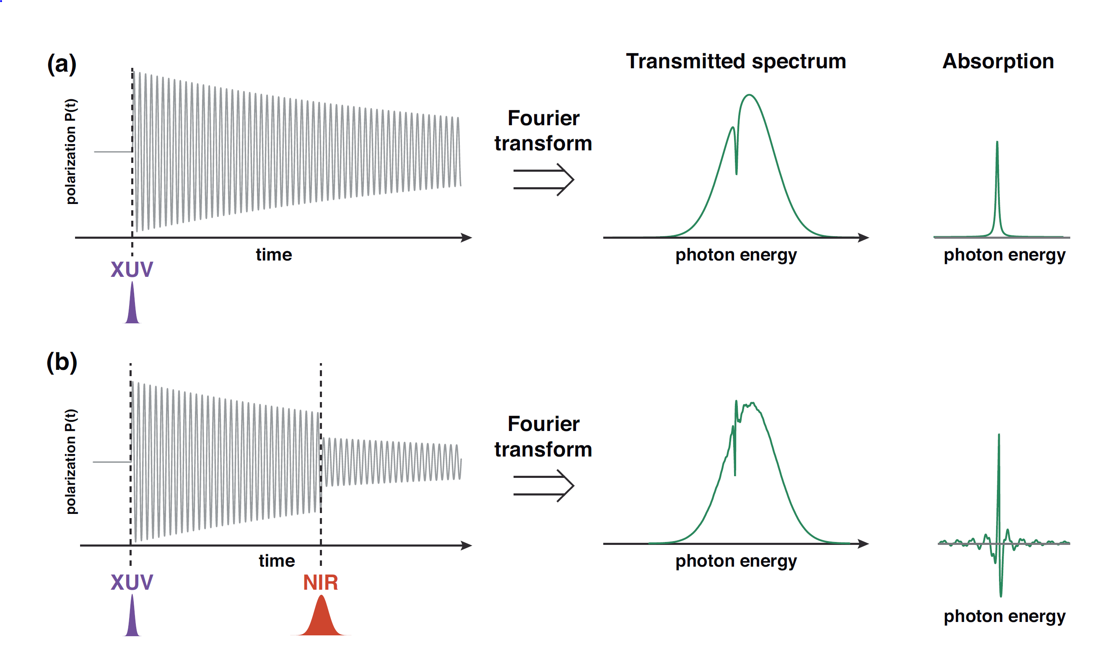
Attosecond transient absorption spectroscopy in gases
XUV induces a polarization in a gas medium
Polarization is macroscopic sum of oscillating dipoles which emit light that interferes with transmitted XUV ➔ absorption feature
An additional pulse perturbs this polarization through interactions with sample ➔ modified absorption feature
By measuring the delay dependent absorption, dynamics can be extracted

Slide 10
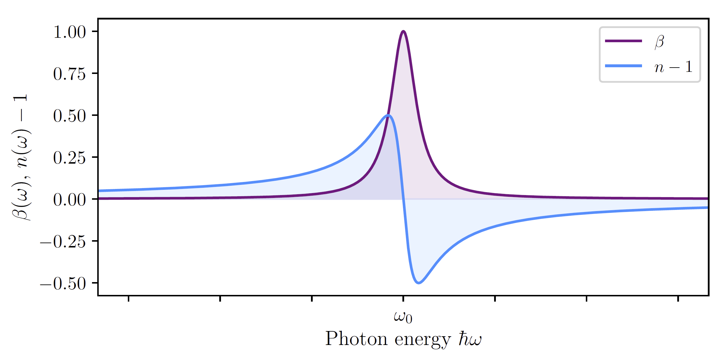
Attosecond transient absorption spectroscopy in gases
Change in absorption → ATS
Change in dispersion → CATS
Generally, absorption is accompanied by dispersion
Without the IR pulse, there are known methods to measure the absorption and dispersion
ATS measures the change in absorption due the IR pulse
CATS measures the change in dispersion due to the IR pule

Slide 11
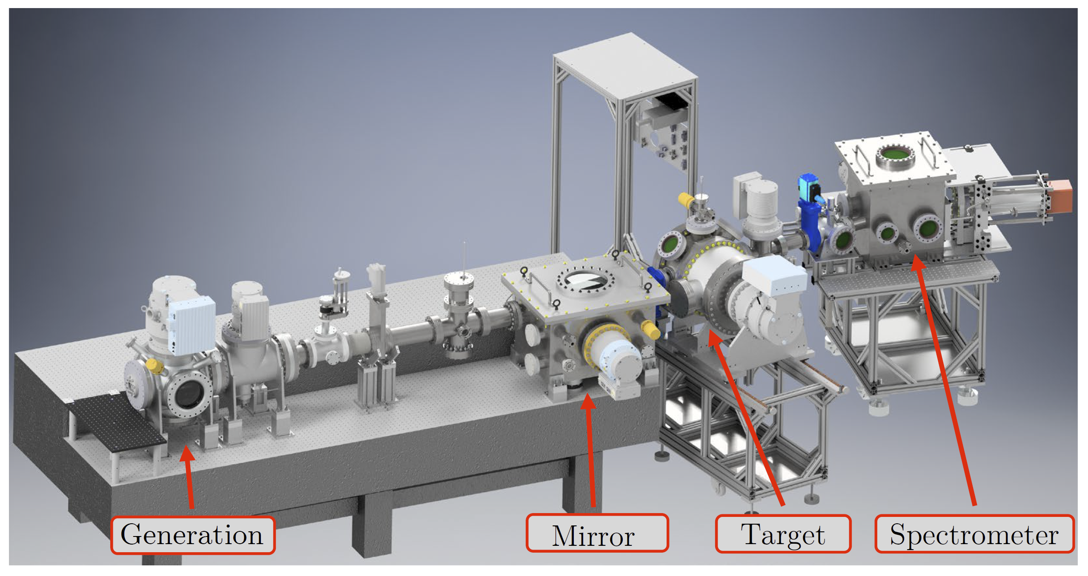
Transient Absorption Beamline (TABLe)

Slide 12
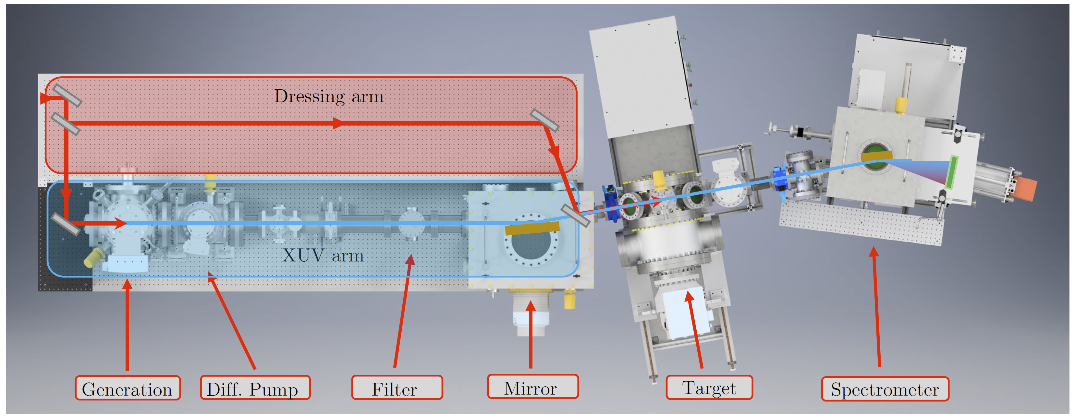
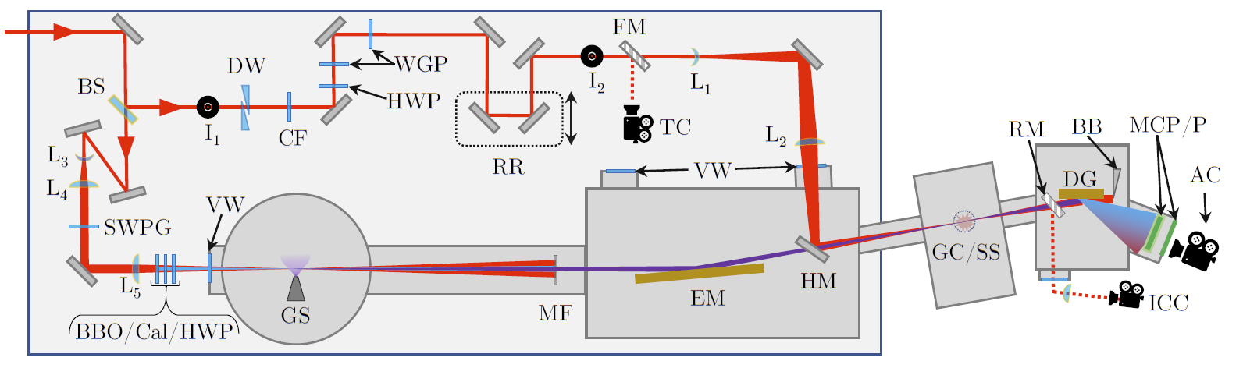
Transient Absorption Beamline (TABLe)
TOPAS
1300 – 1550 nm, 60 fs, 3 mJ, 1 kHz

Slide 13
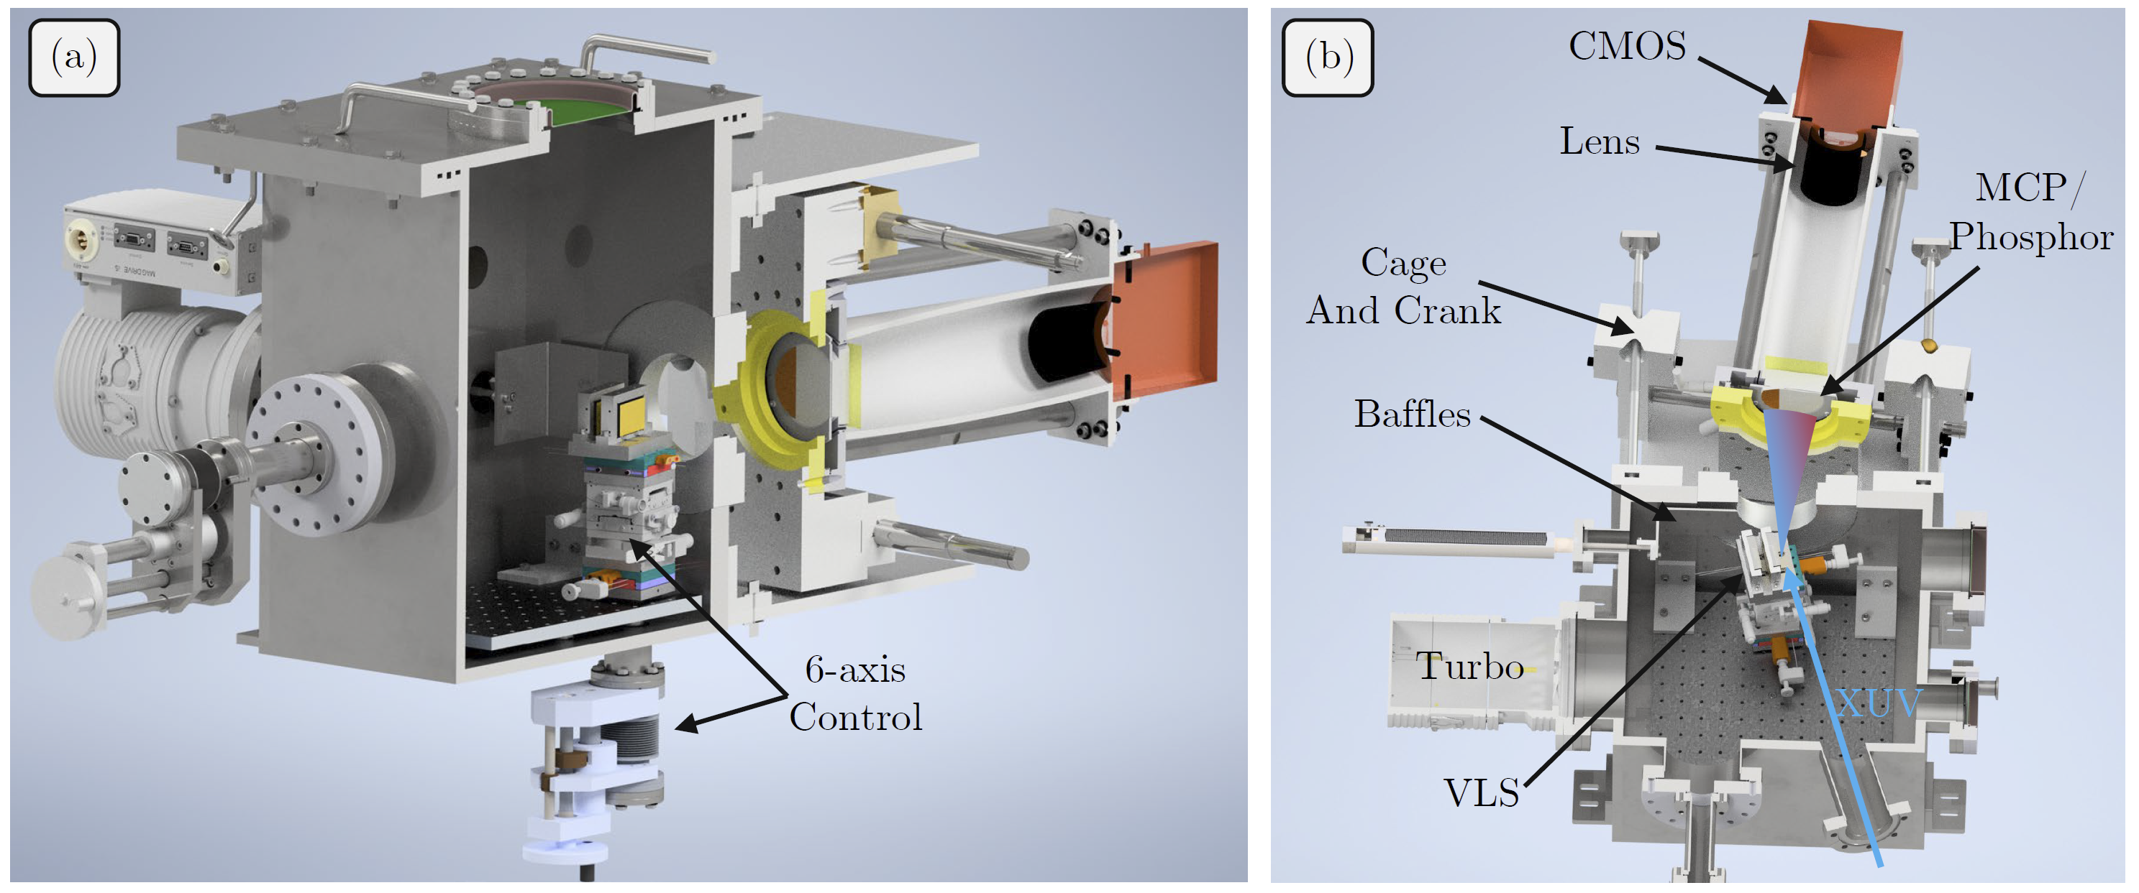
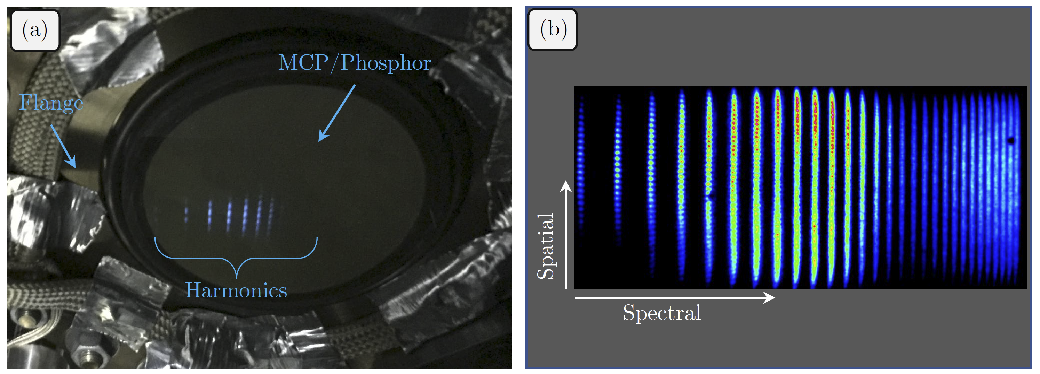
TABLe Spectrometer

Slide 14
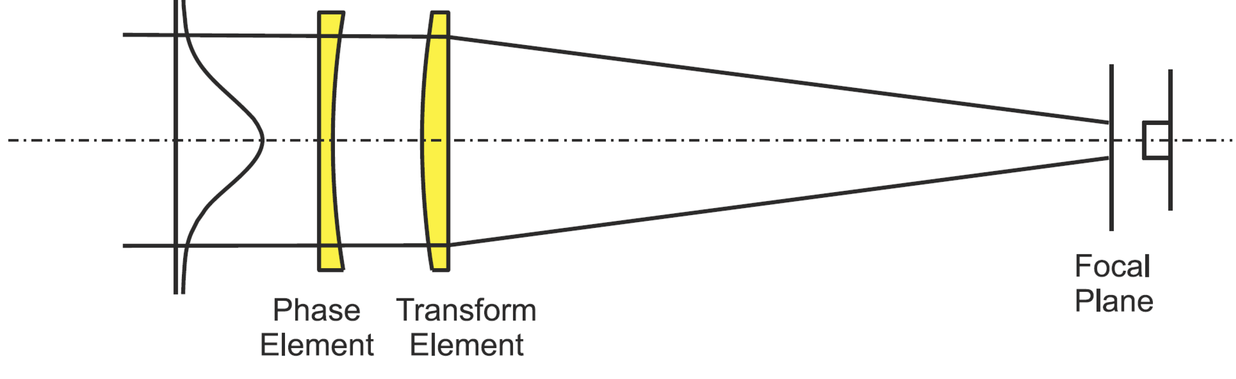
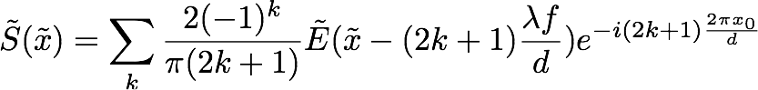
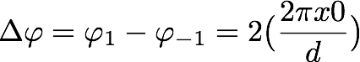
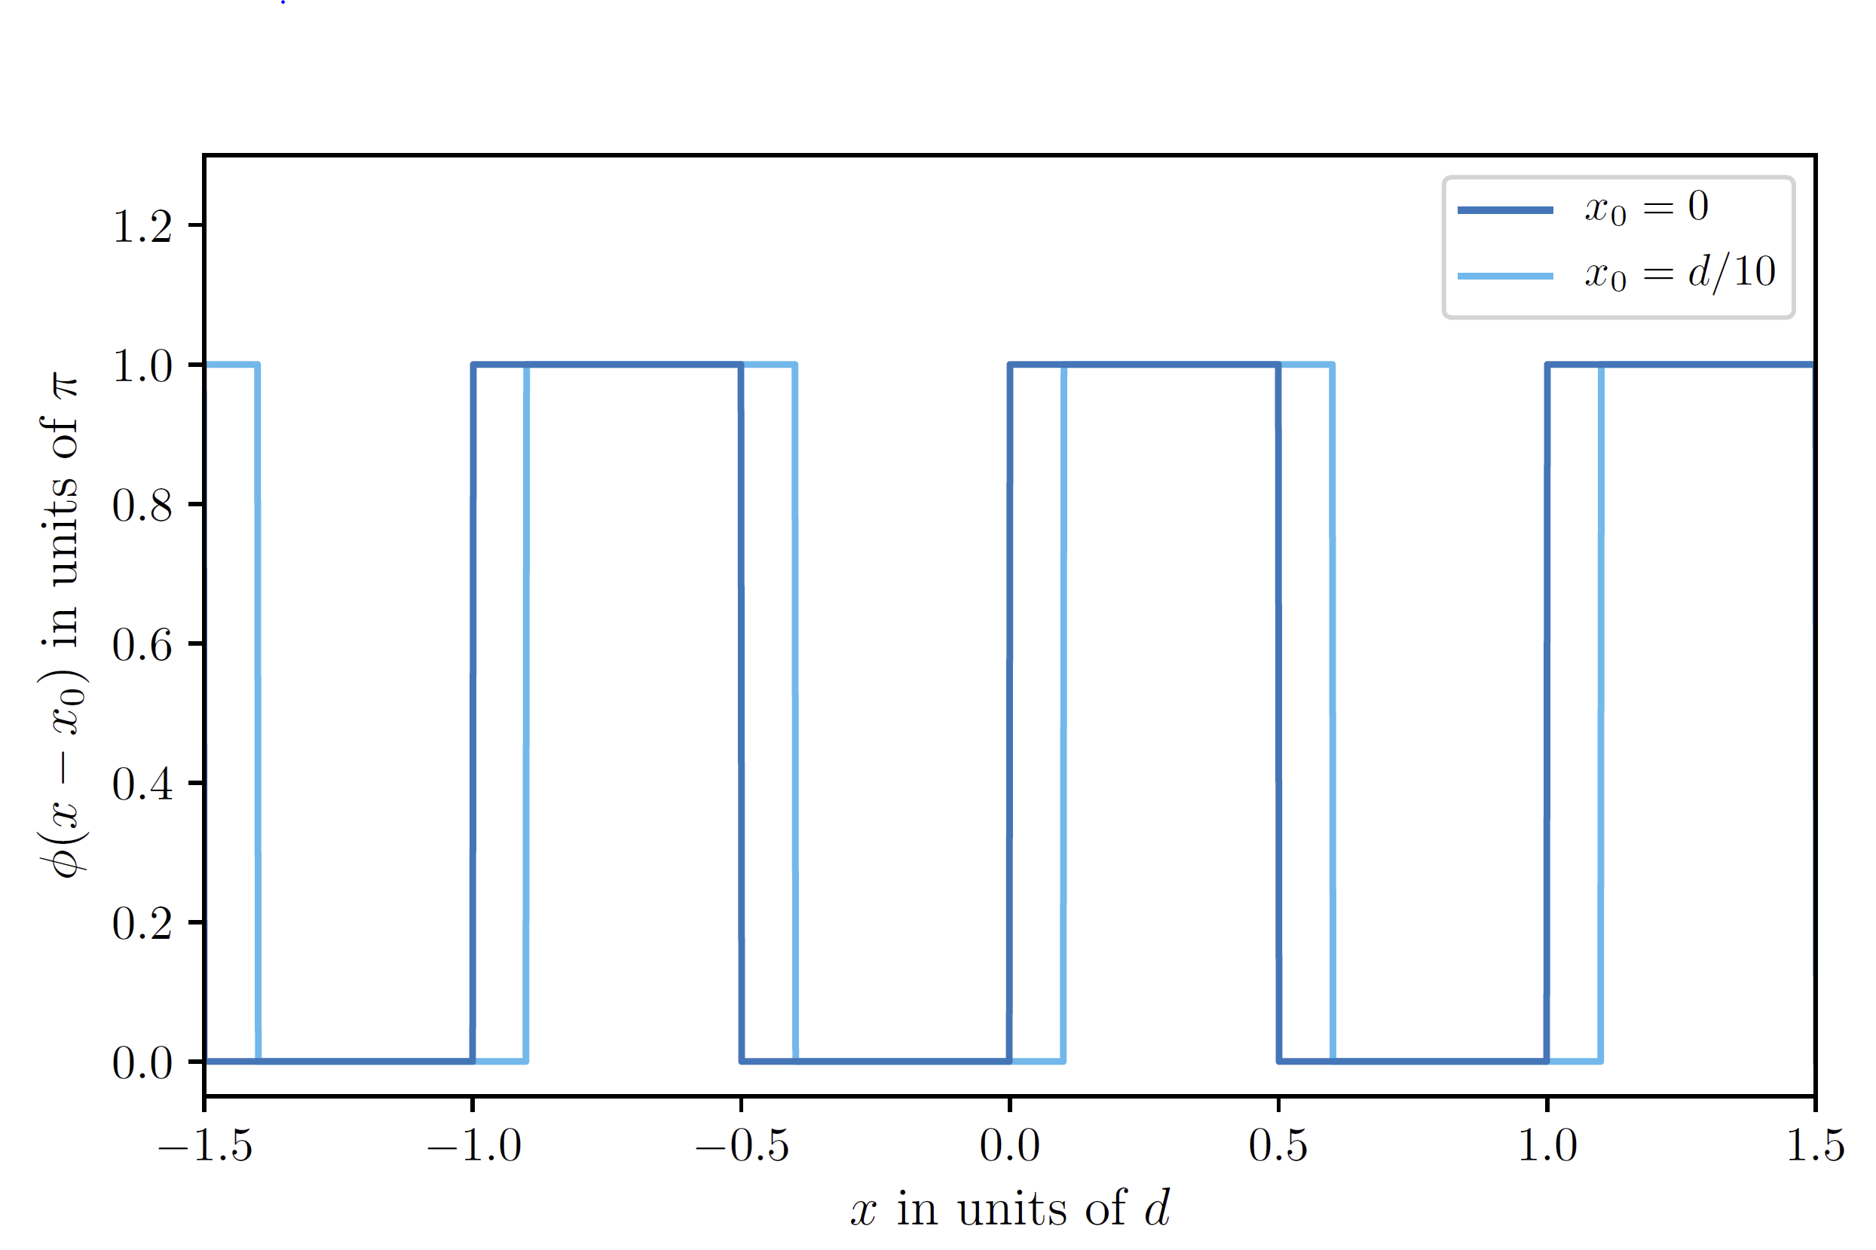
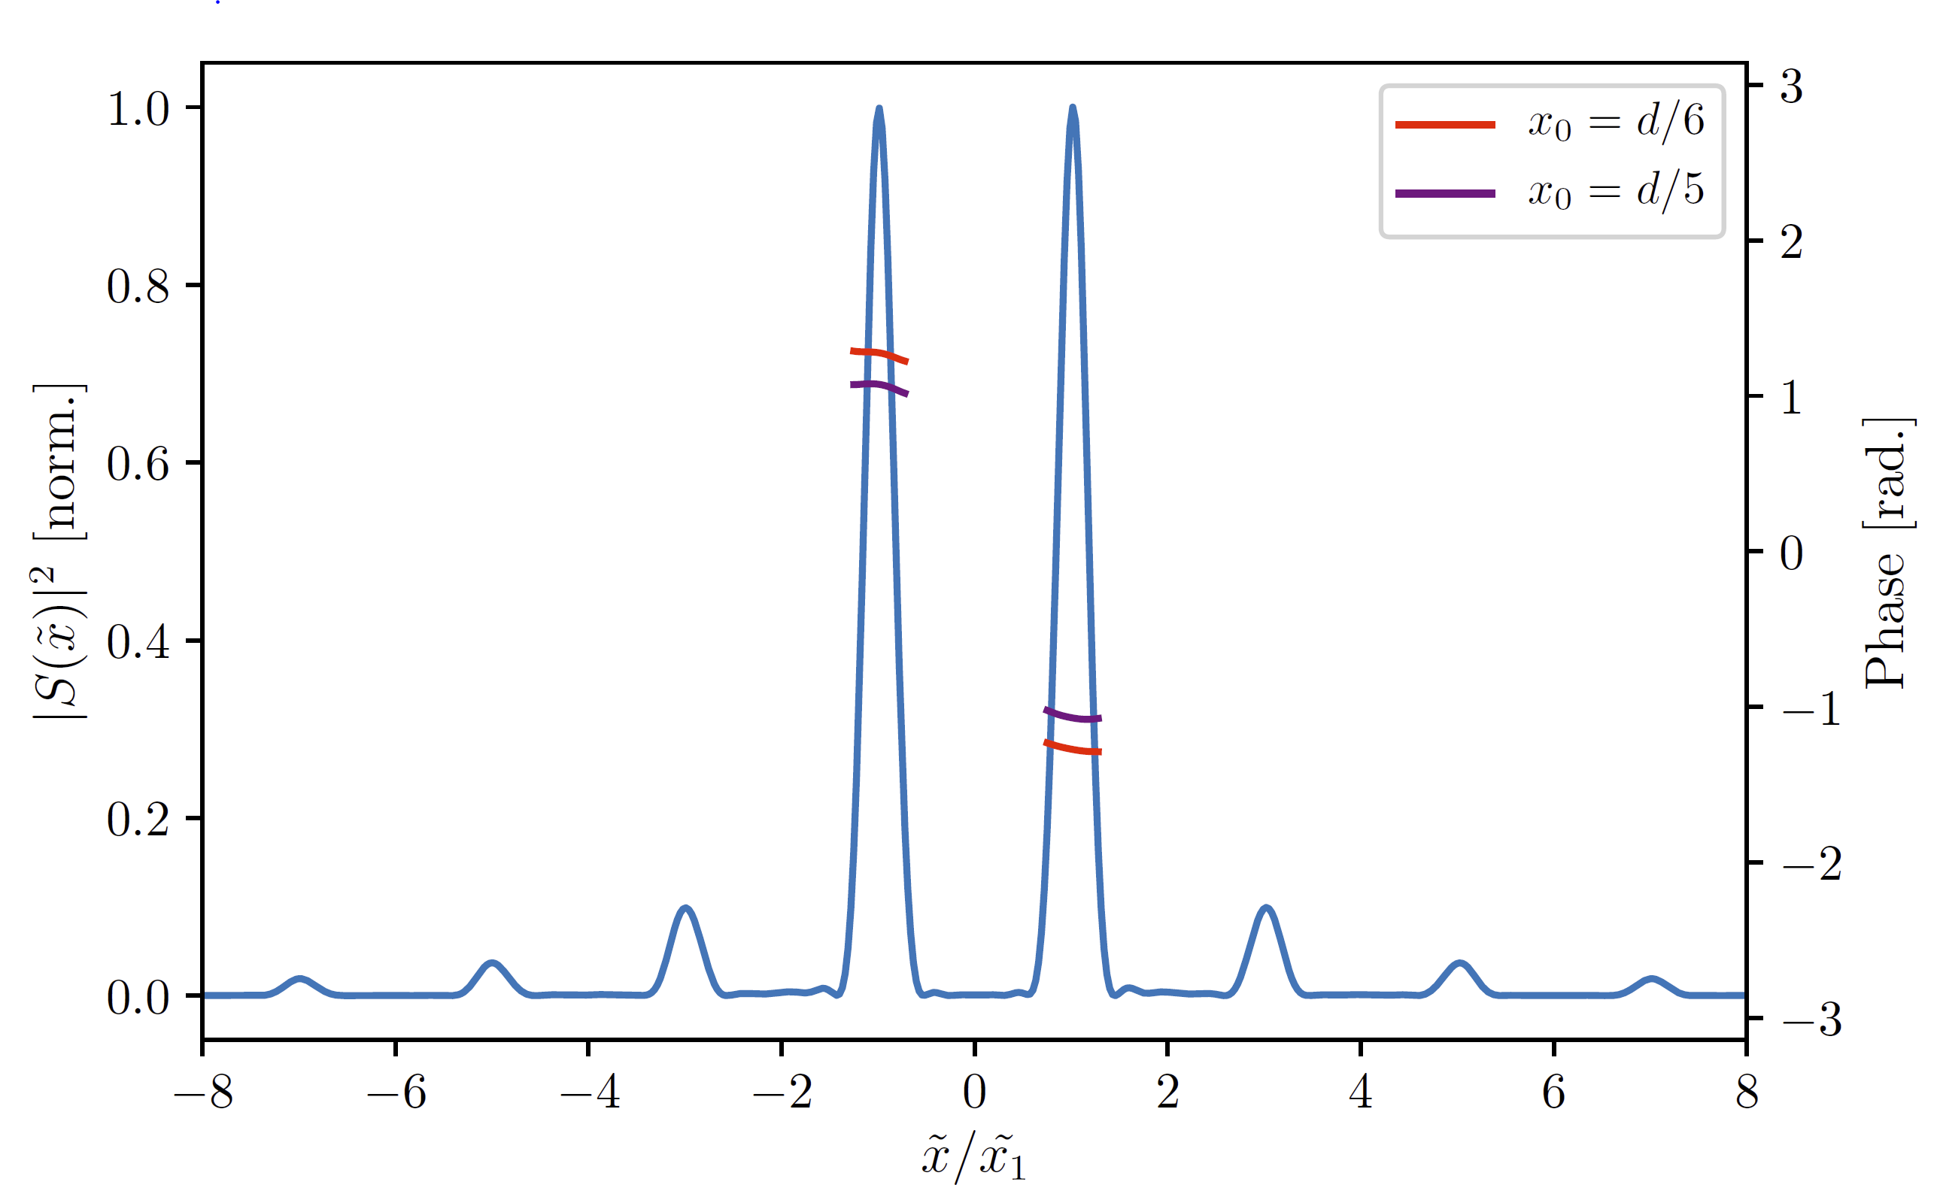
Square-Wave Phase Grating (SWPG)
Field at the focus
Relative phase between ±1 orders
Beam shaping is done using a square wave phase grating
This allows us to two create two duplicates of the input IR field, and each will generate XUV
The phase grating allows for high-precision control over the relative phase between the two sources

Slide 15
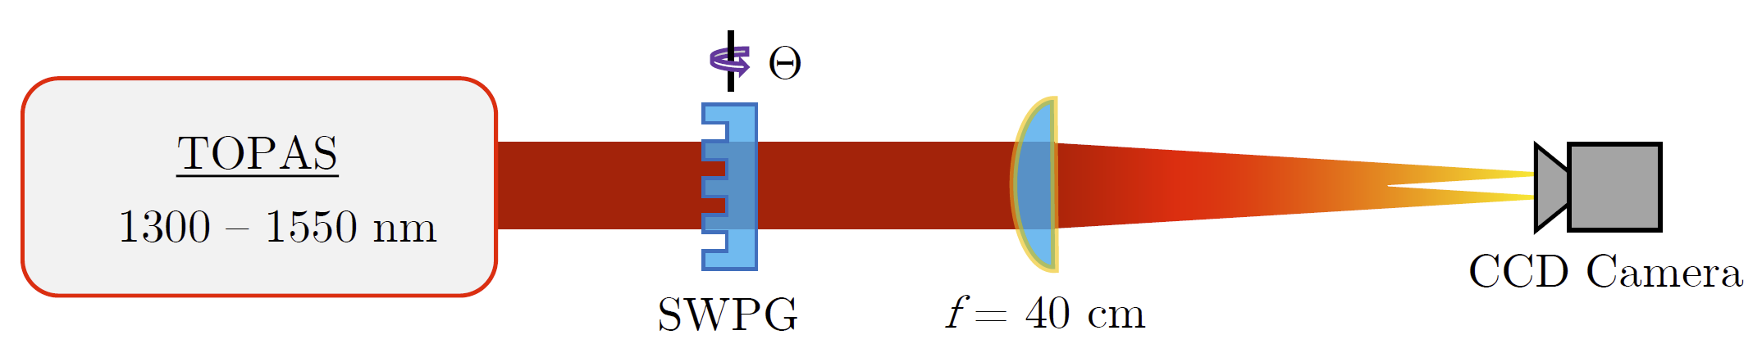
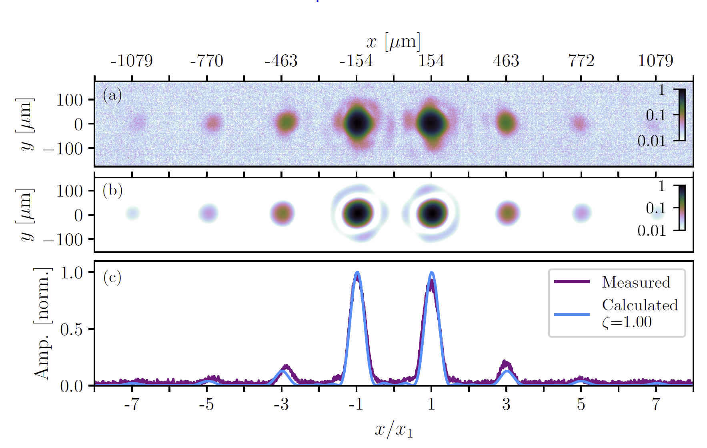
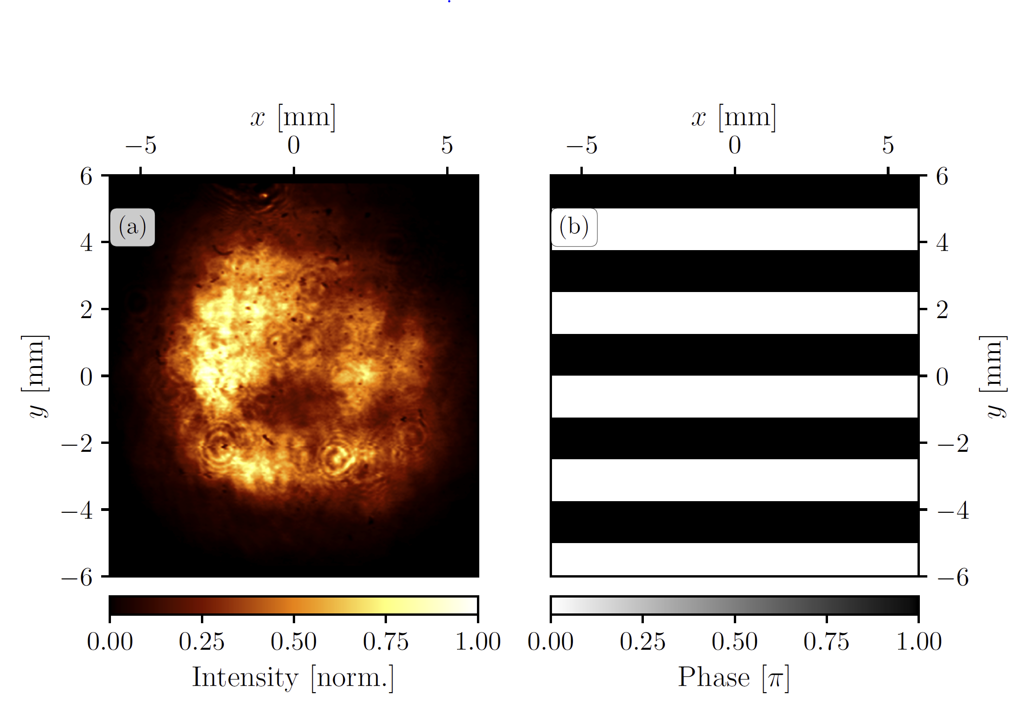
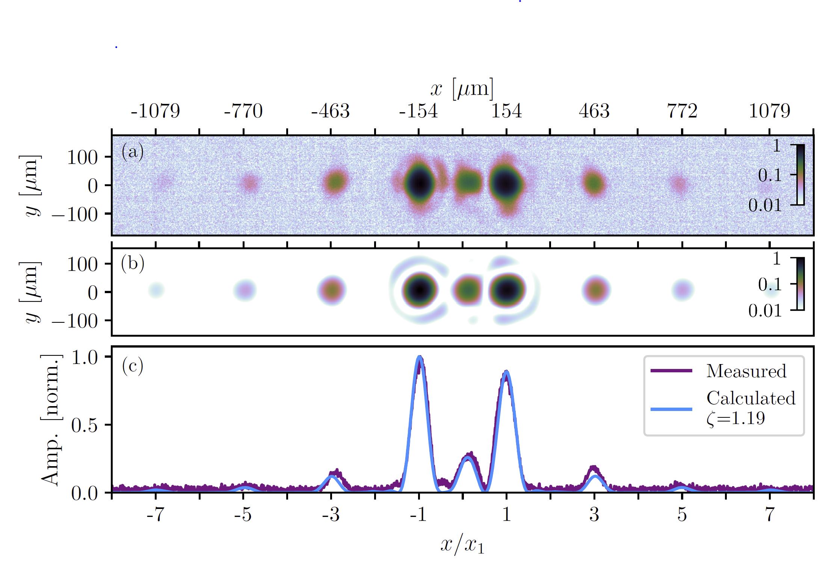
SWPG Beam Profile Measurement

Slide 16
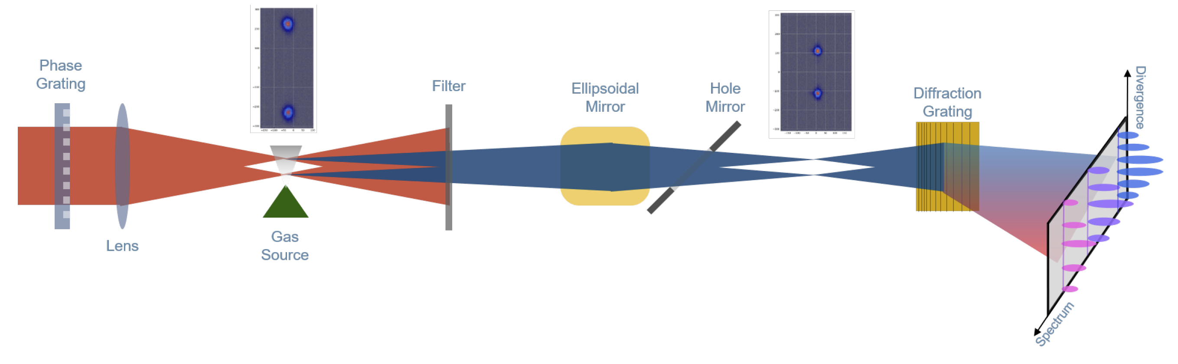
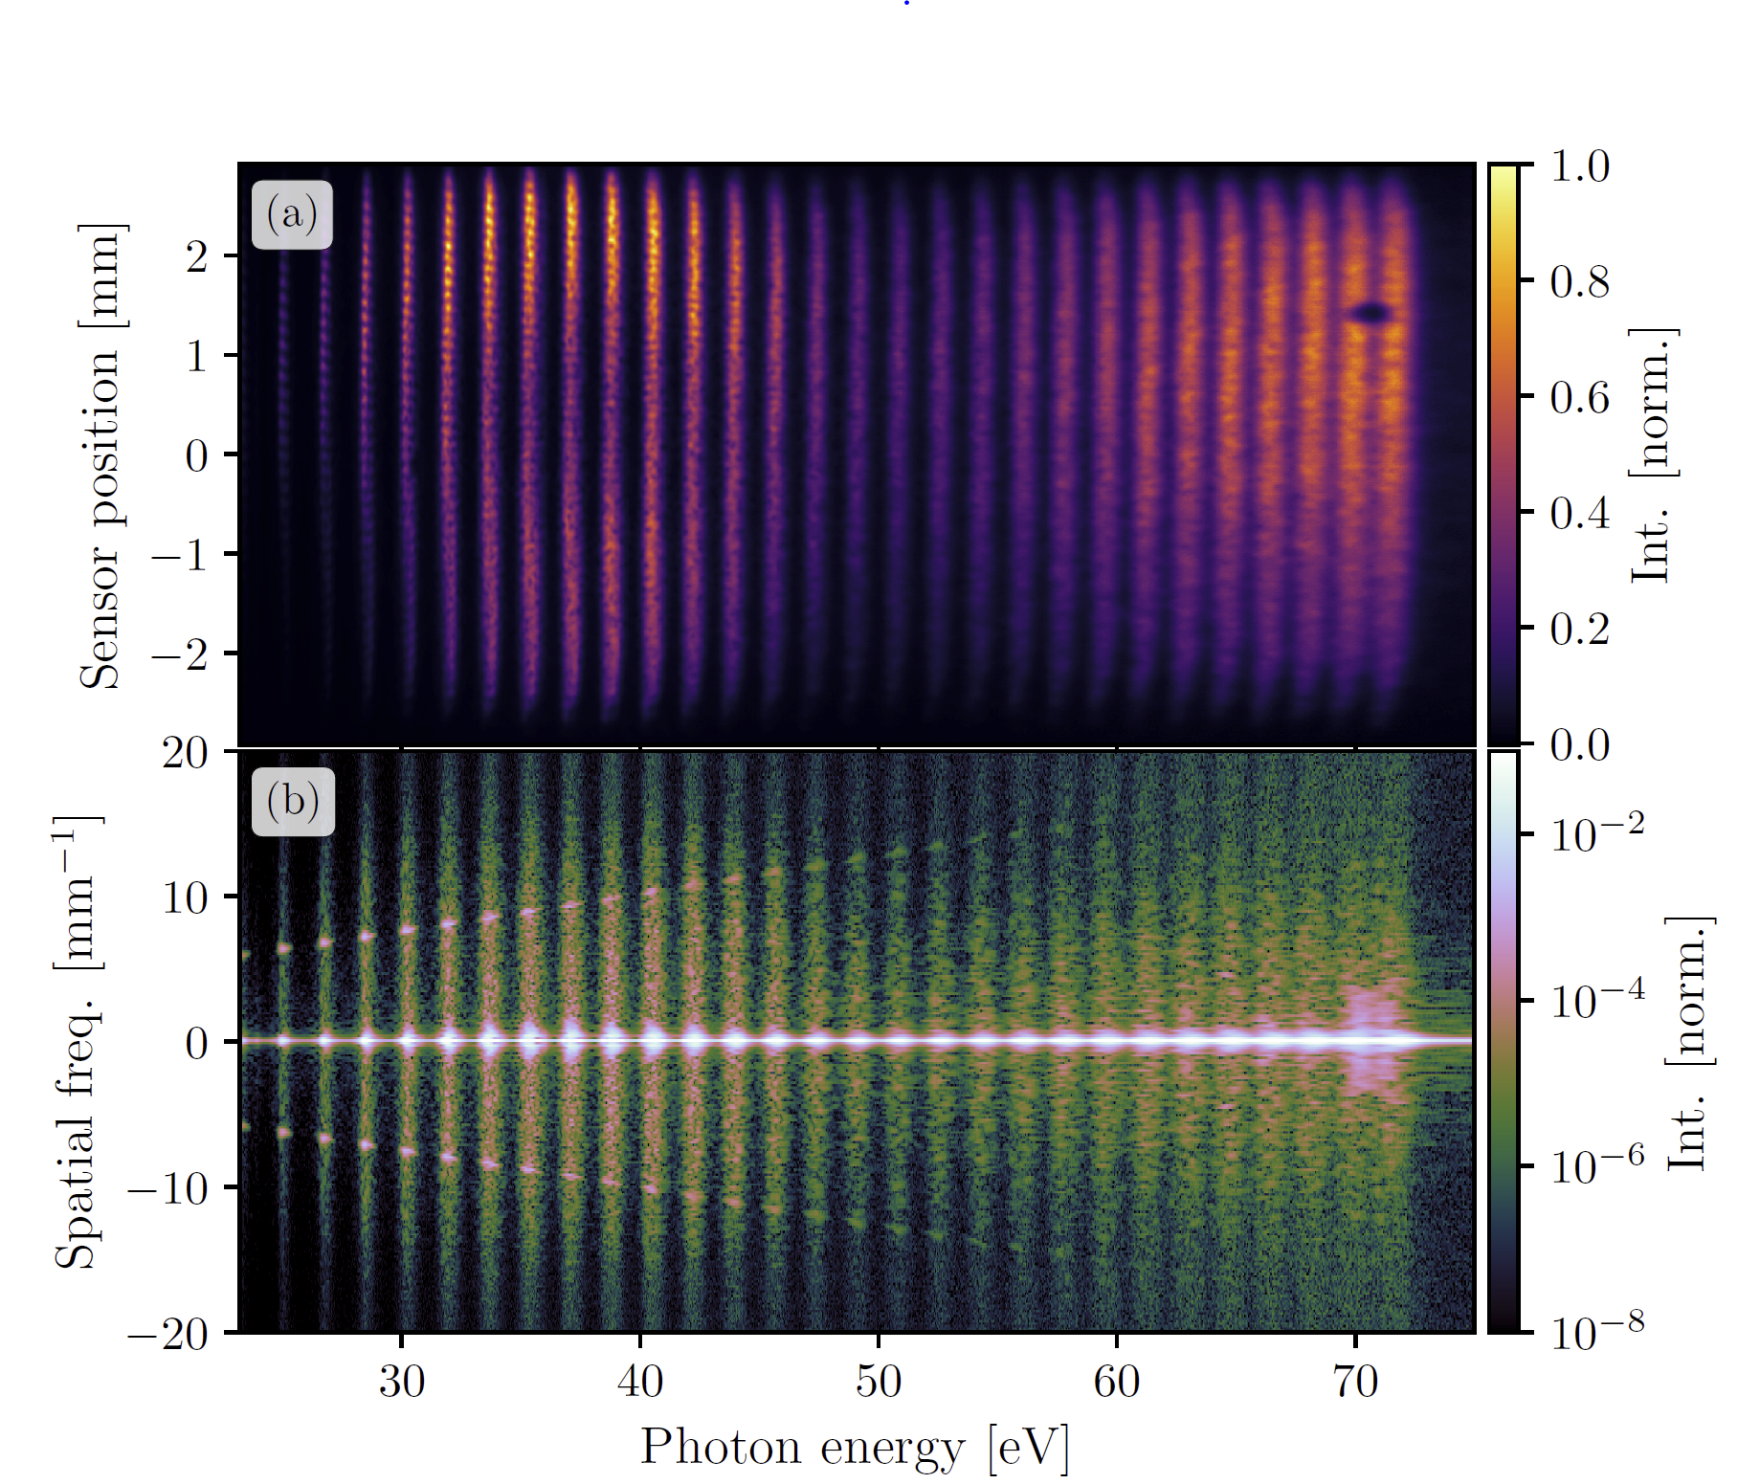
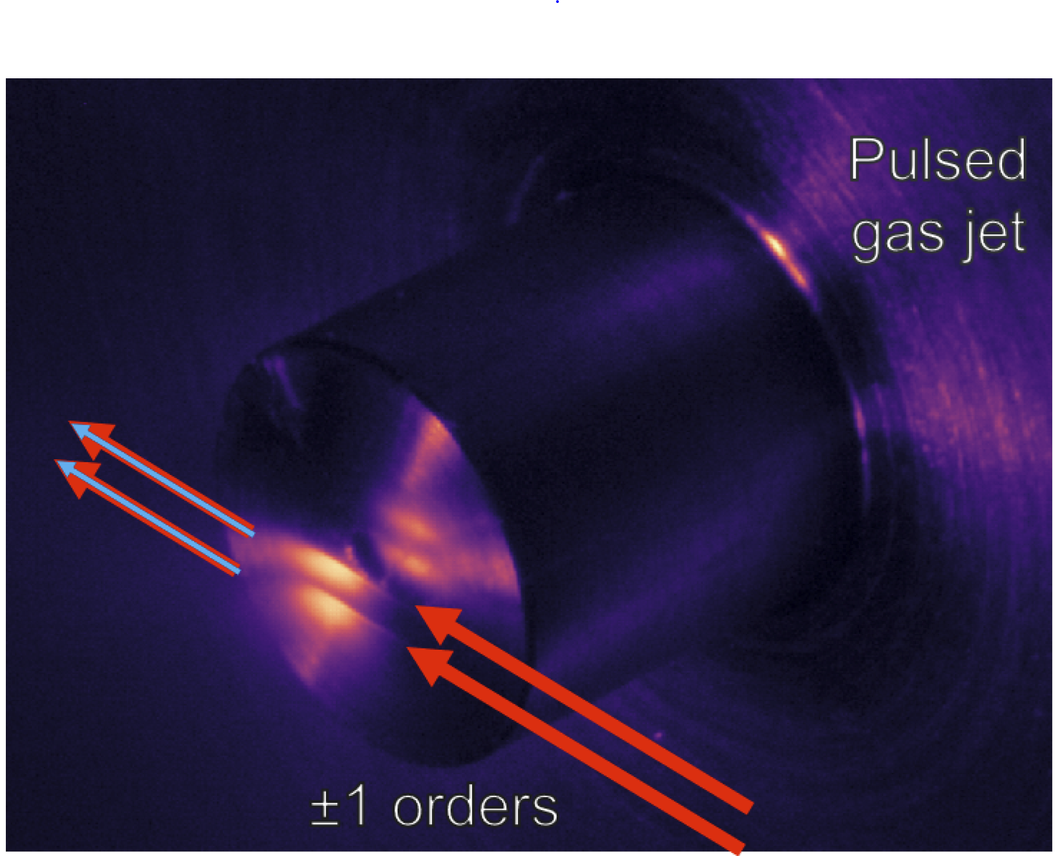

Slide 17
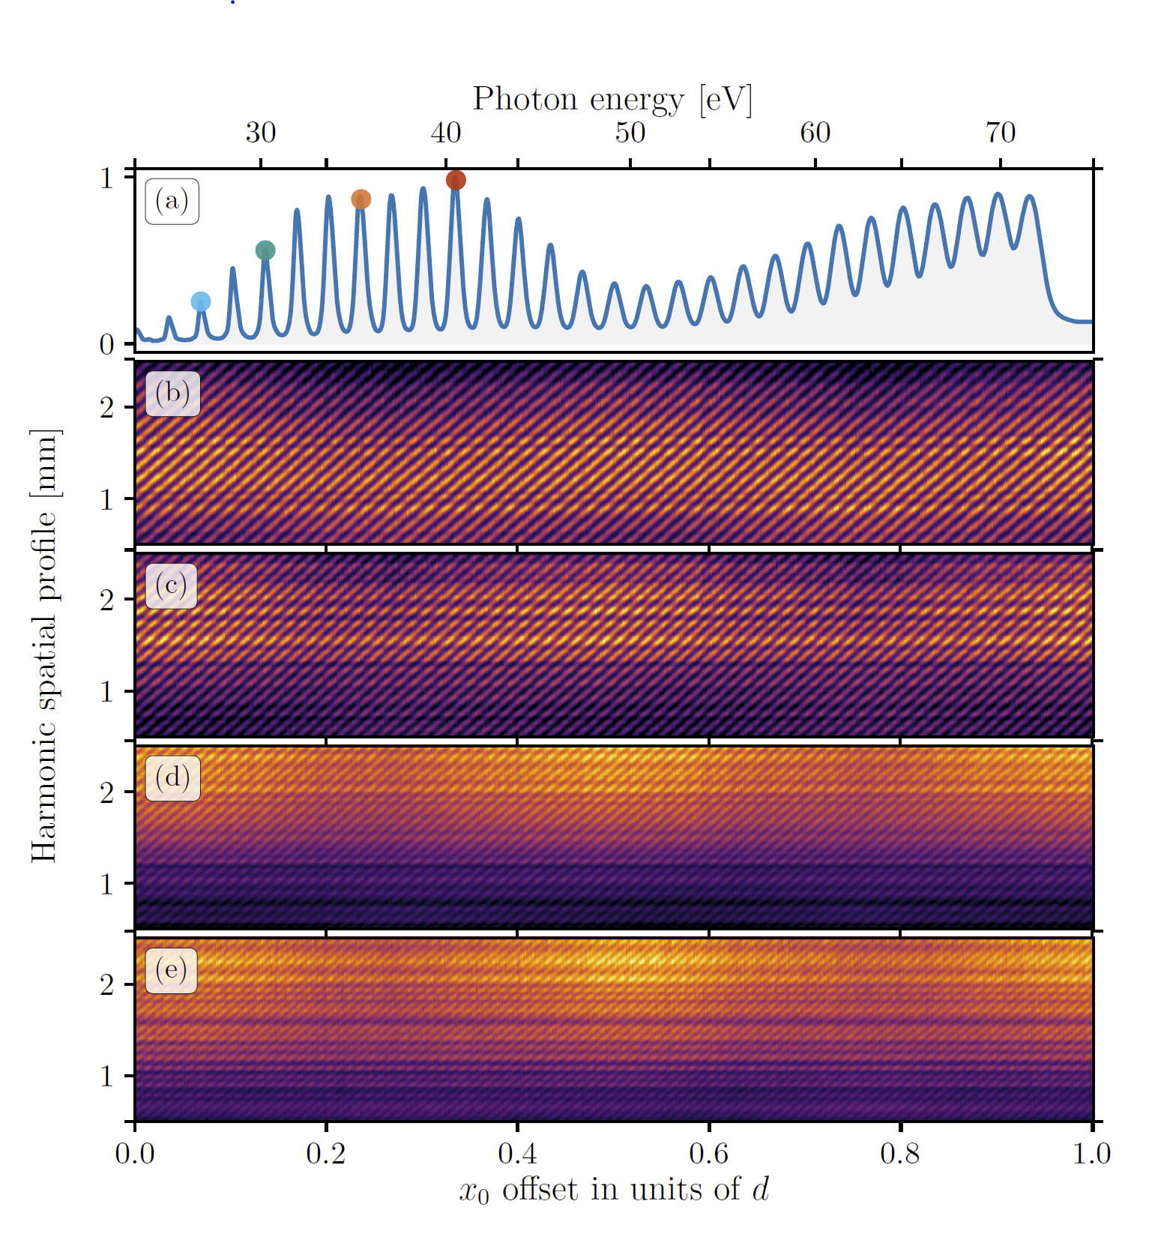
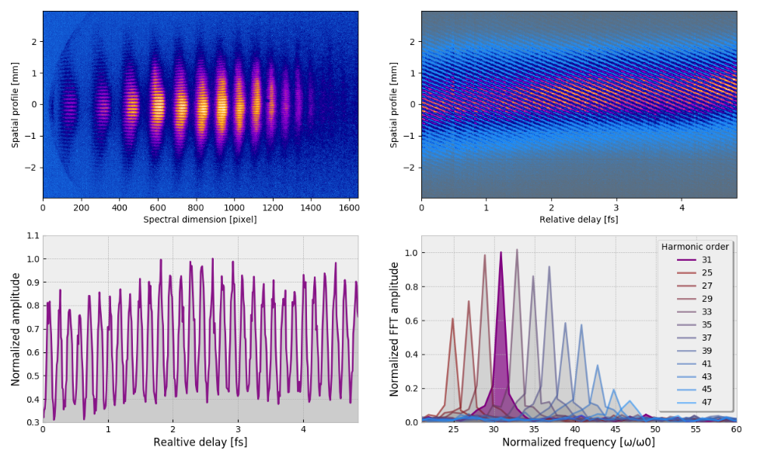
H31
H31
H31

Slide 18
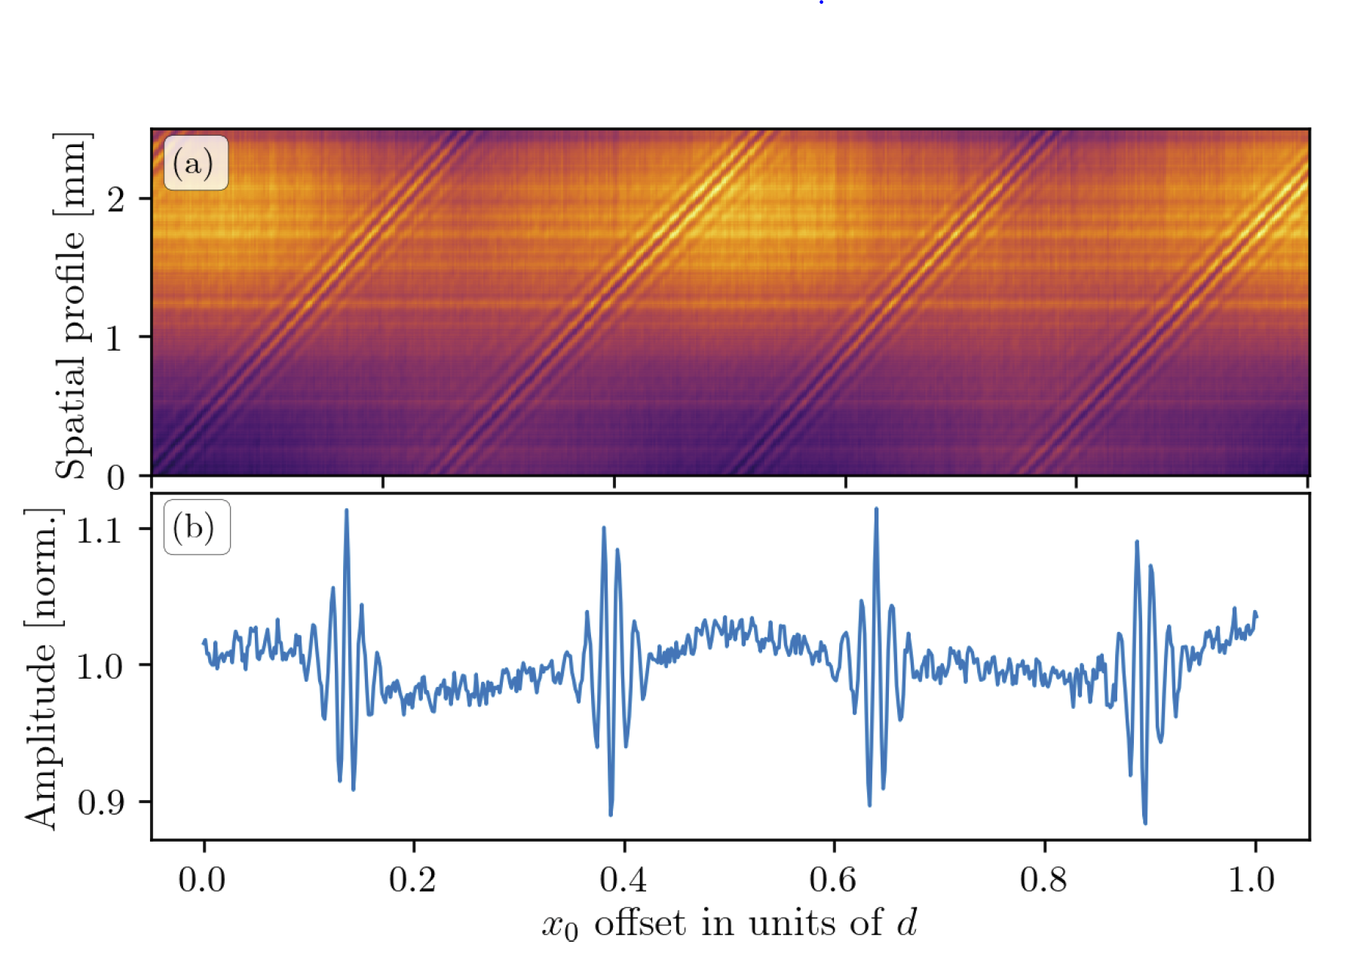
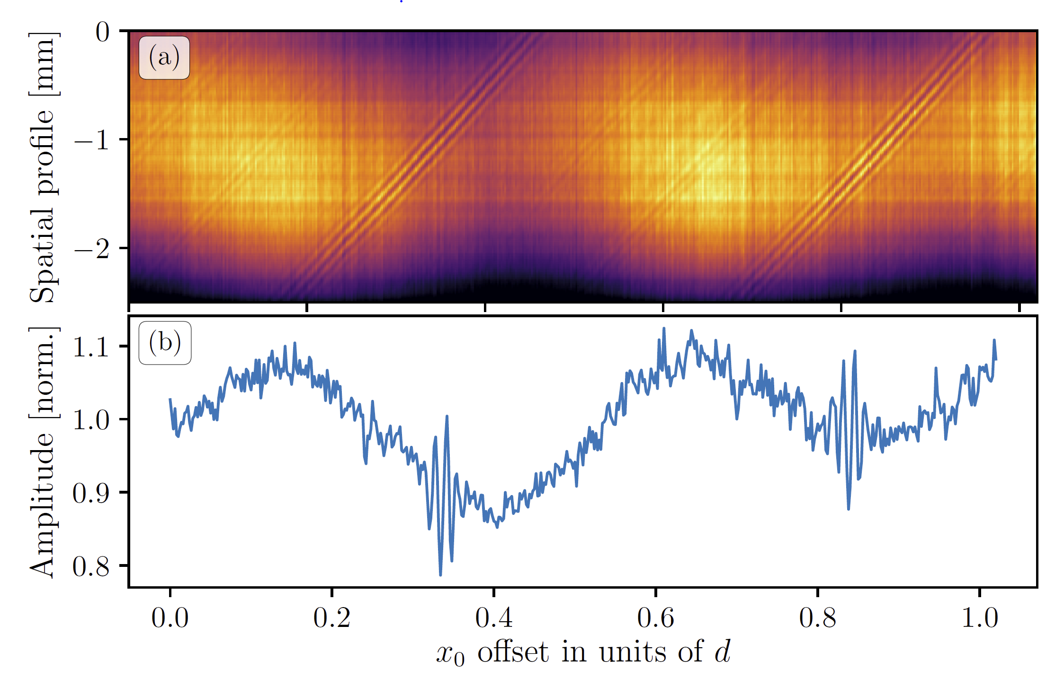

Slide 19
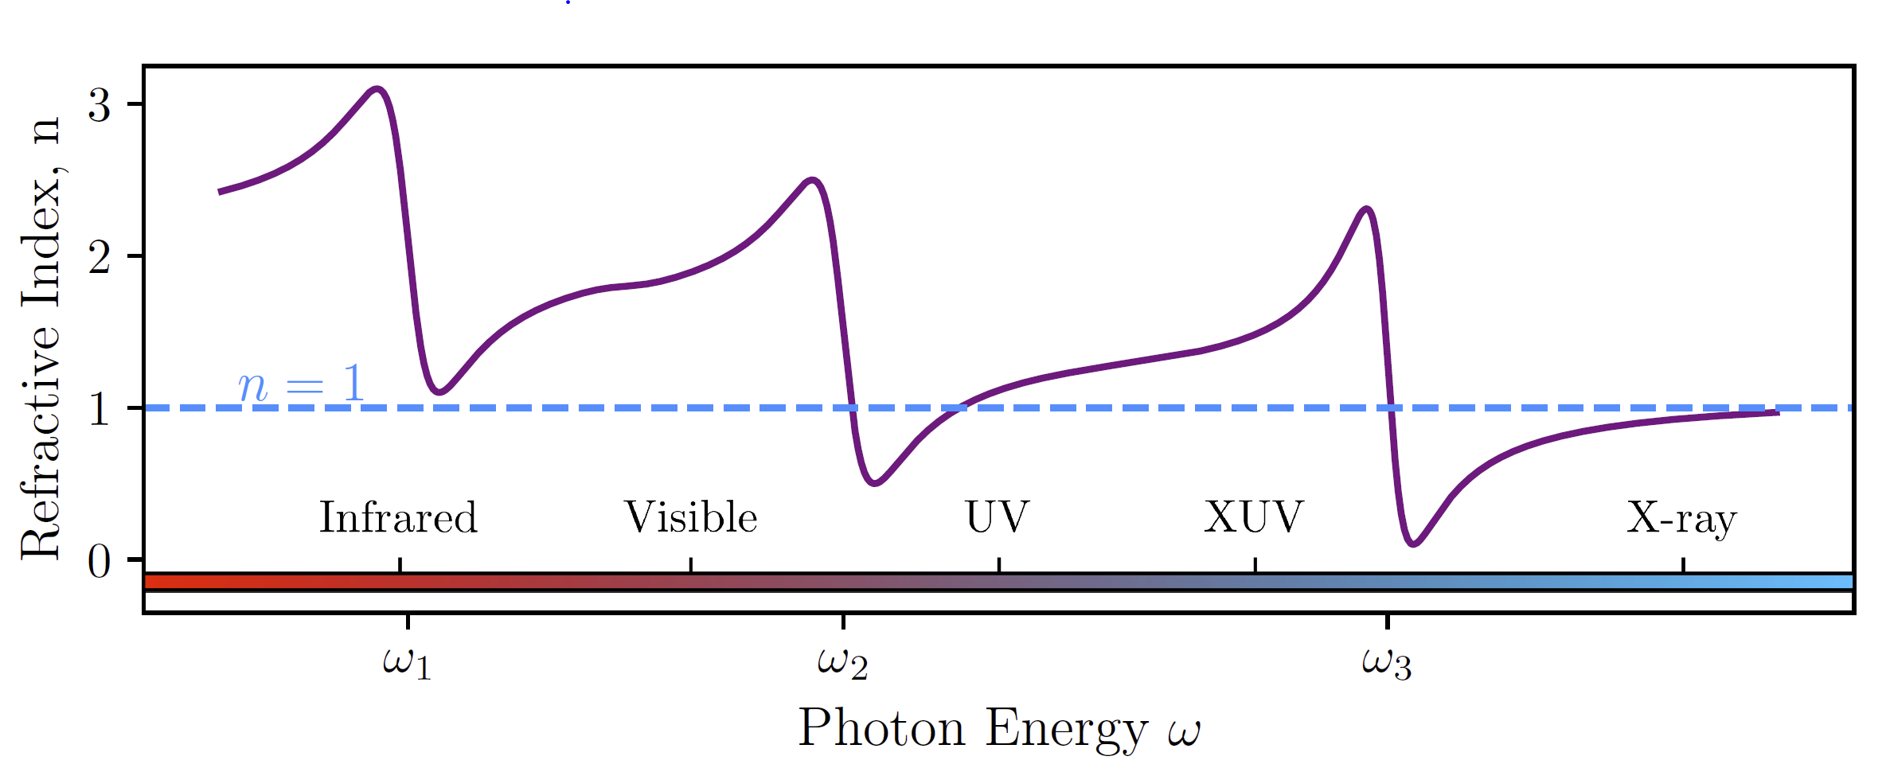

Slide 20
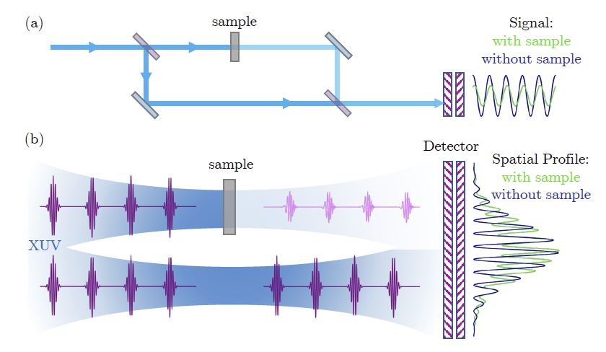
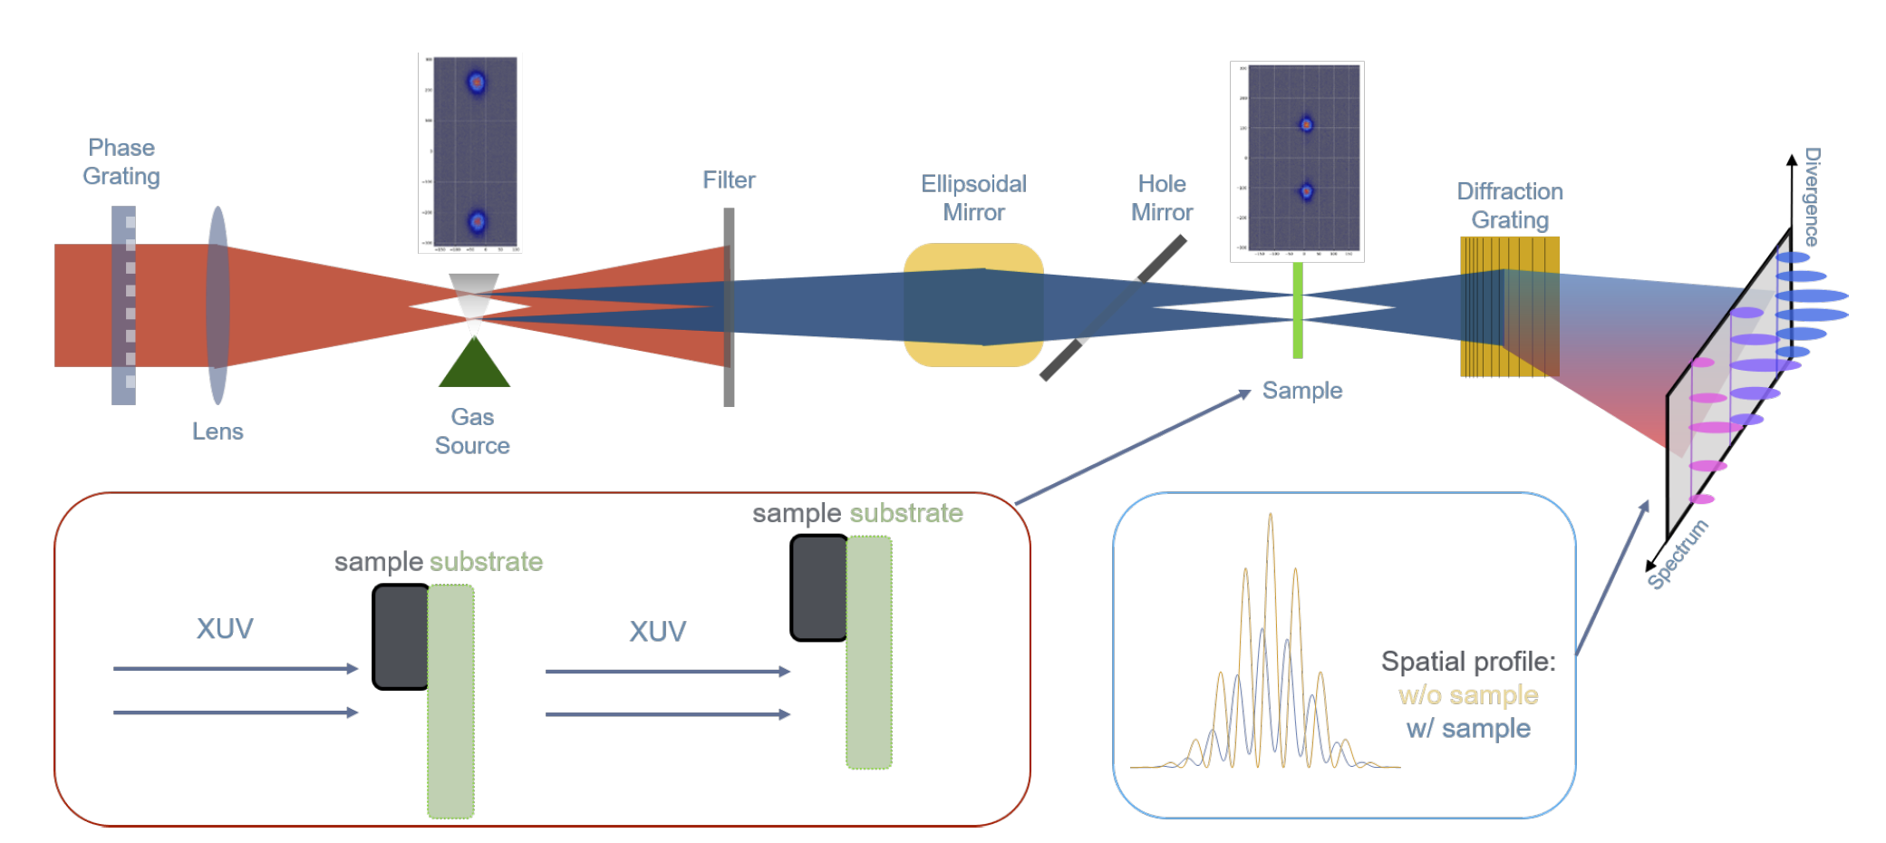

Slide 21
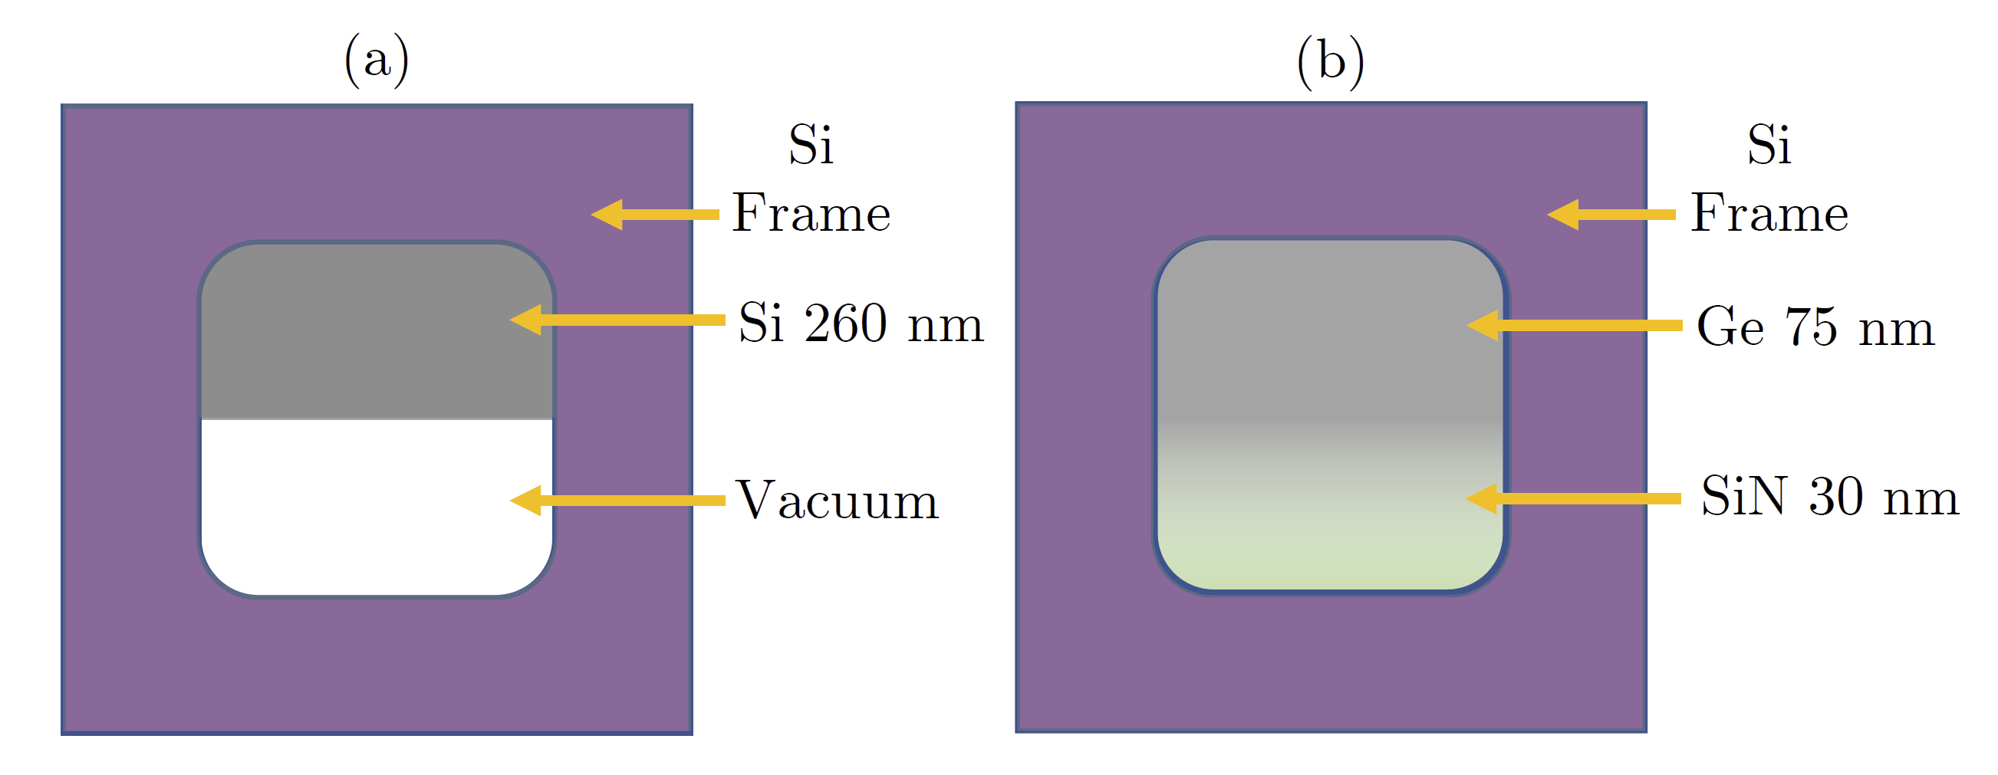
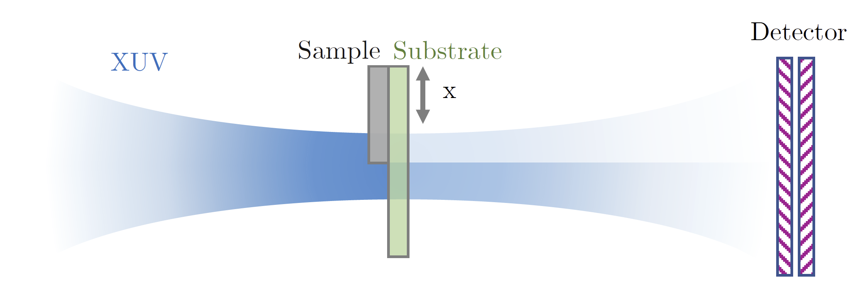
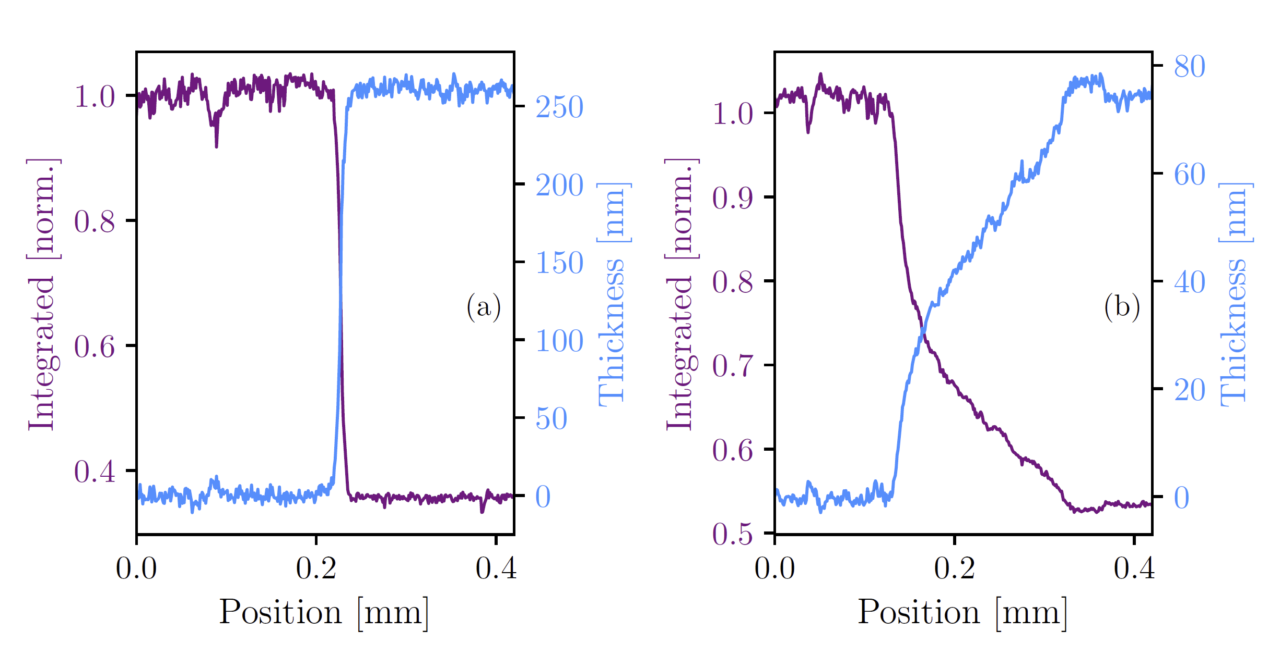

Slide 22
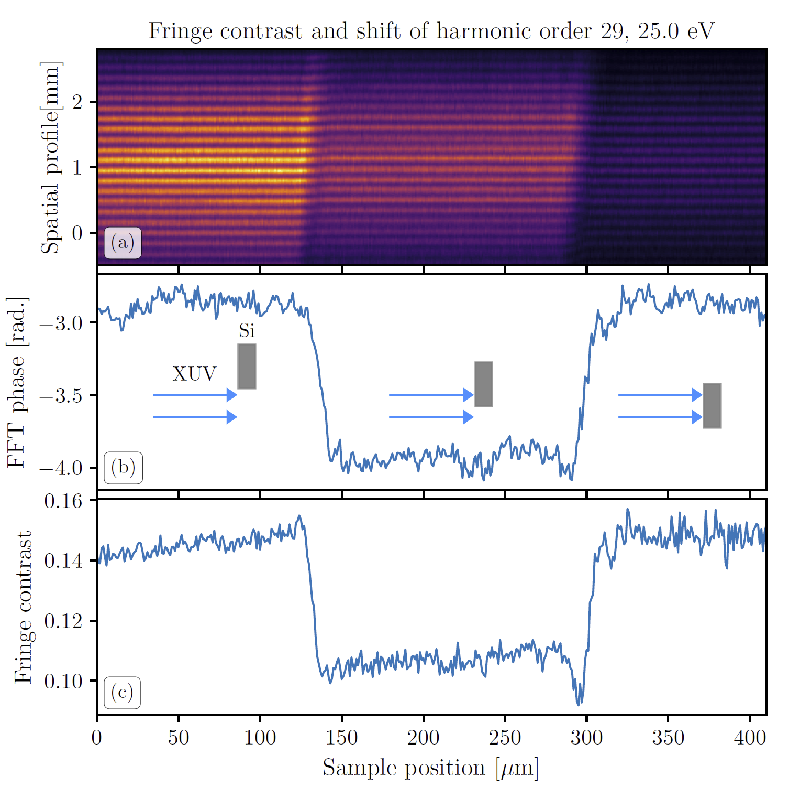
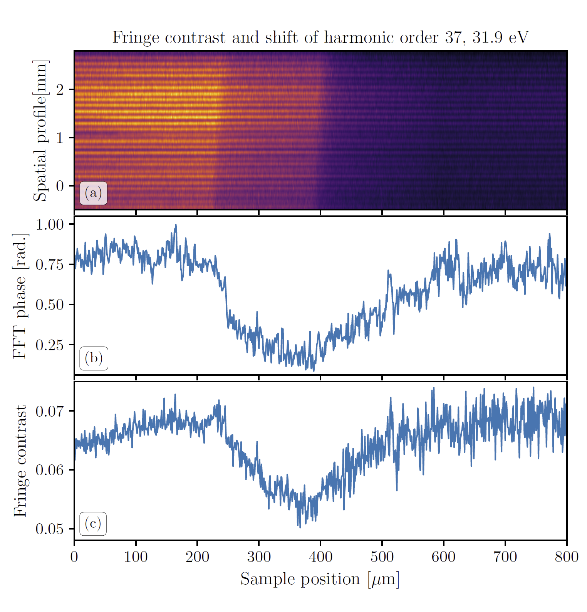

Slide 23
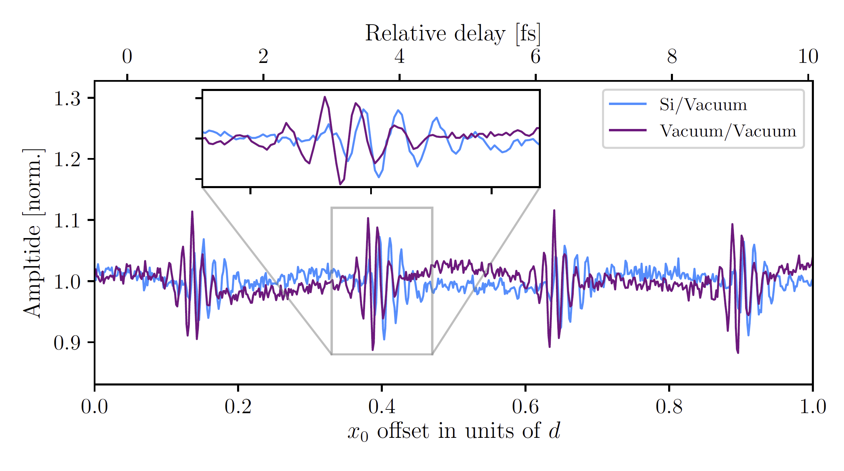
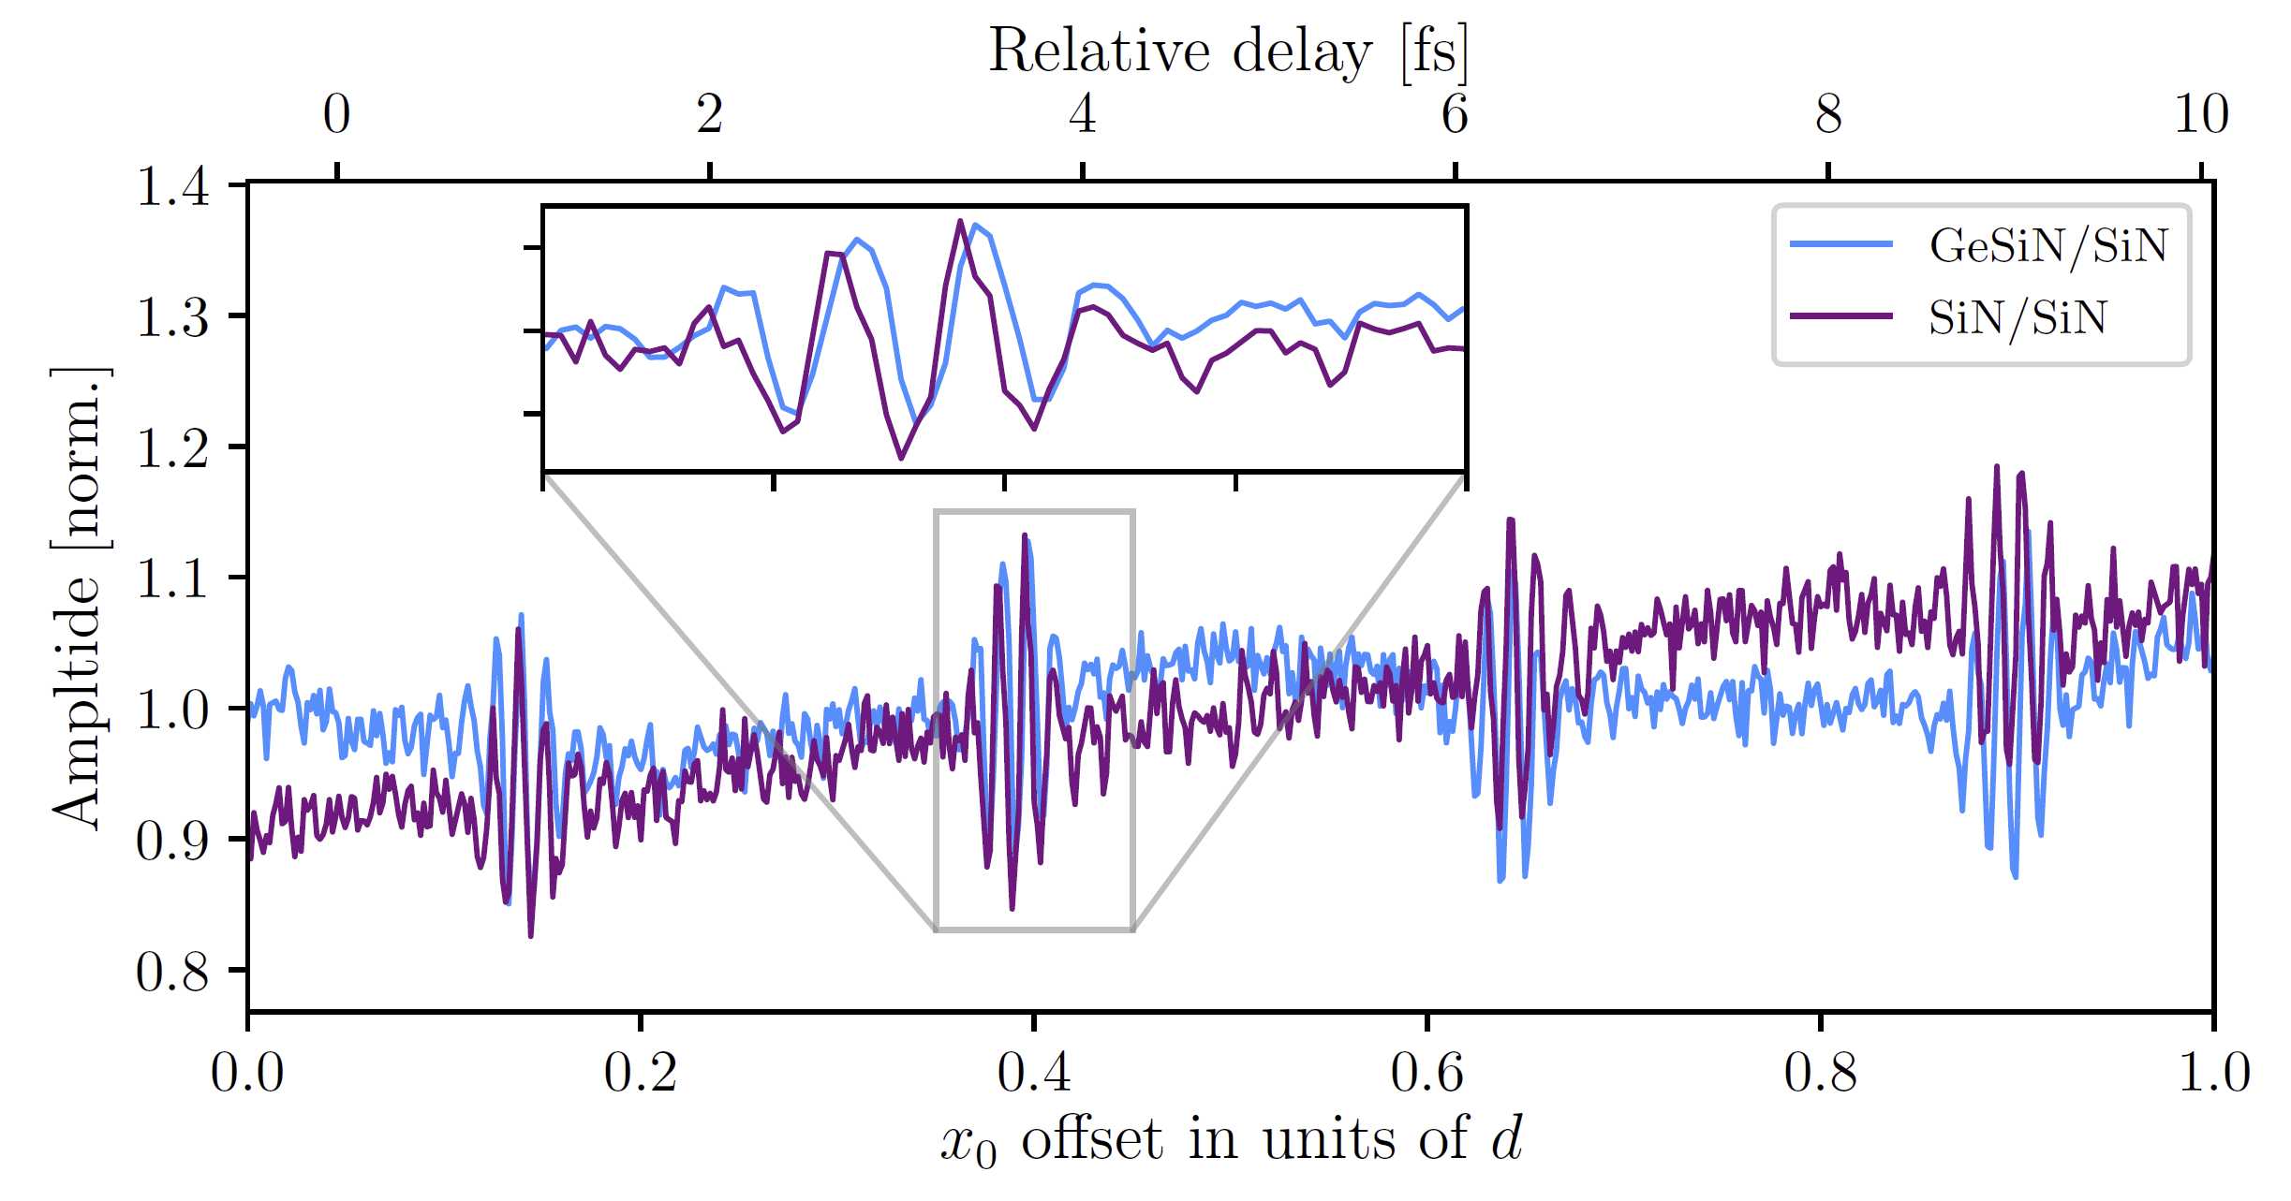

Slide 24
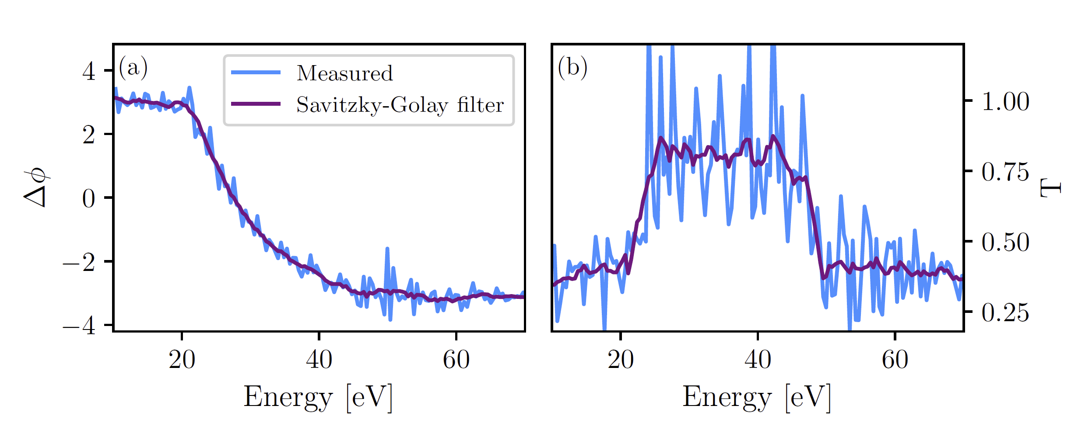
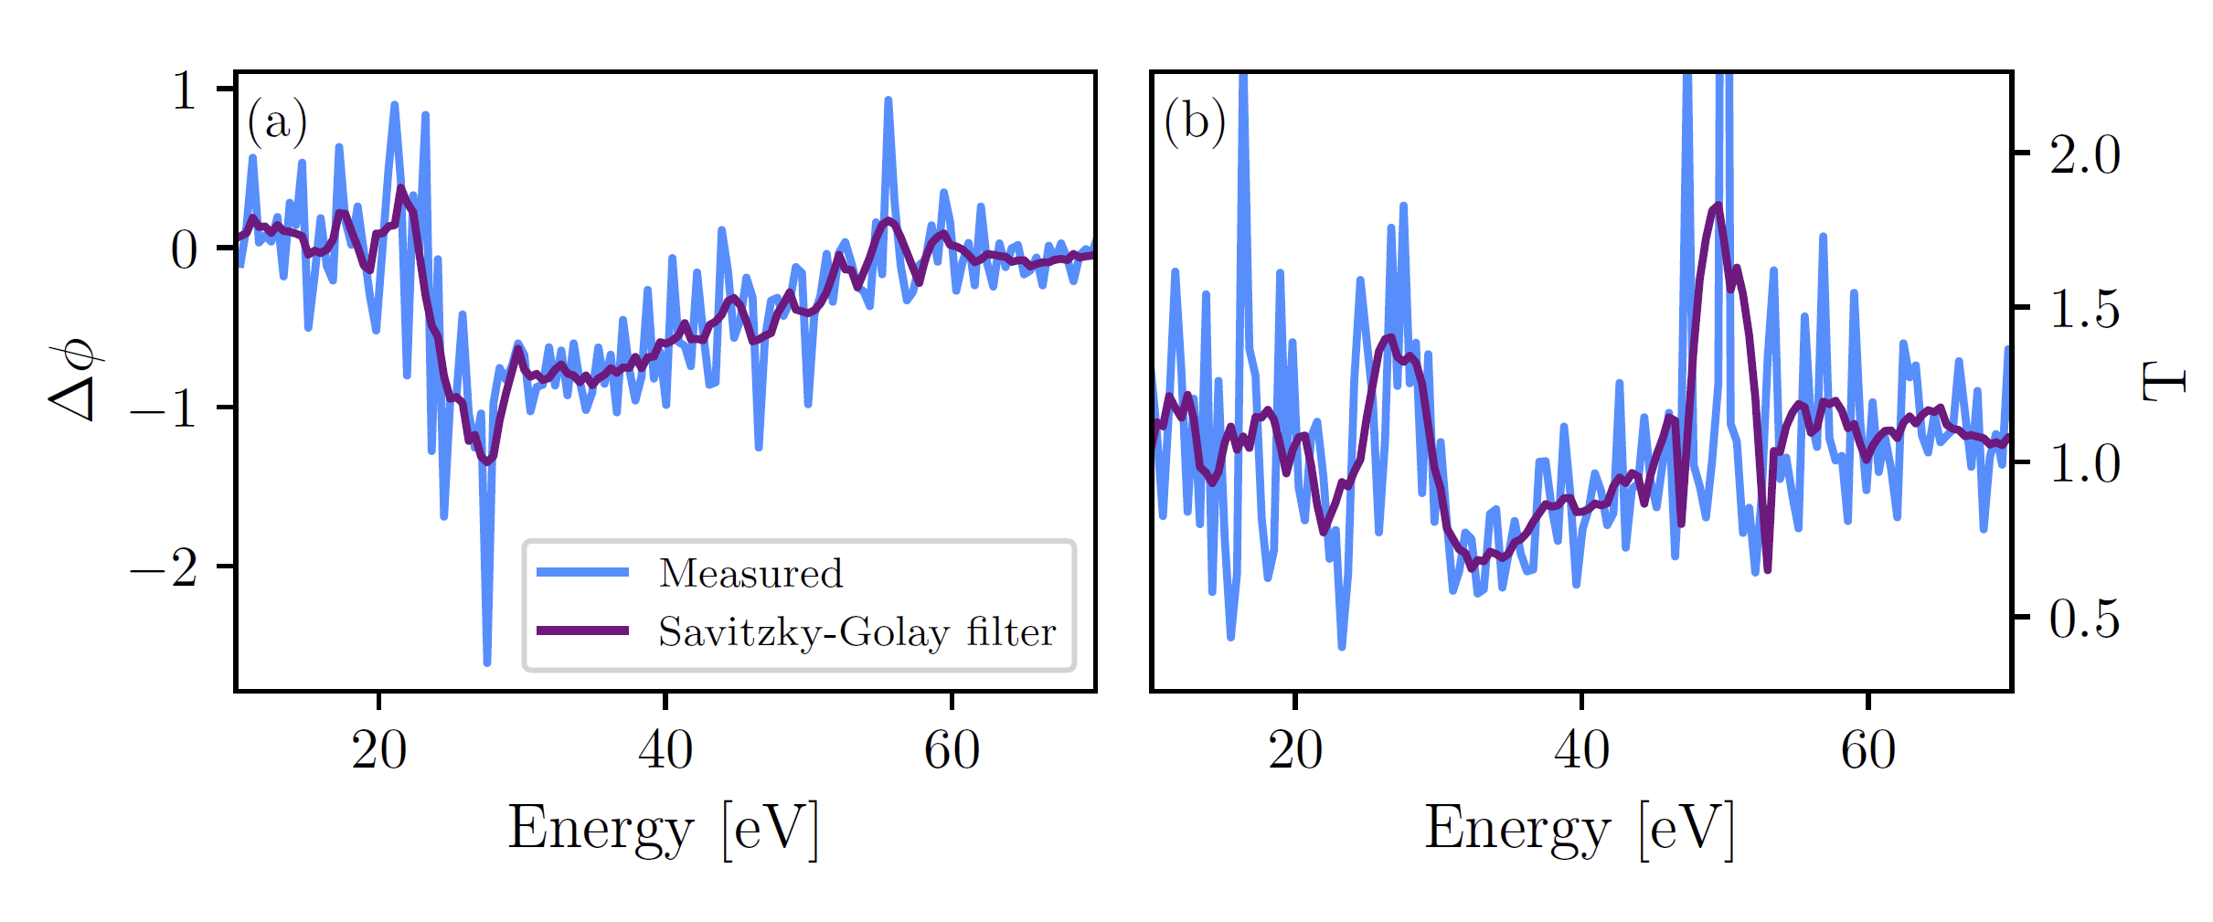

Slide 25
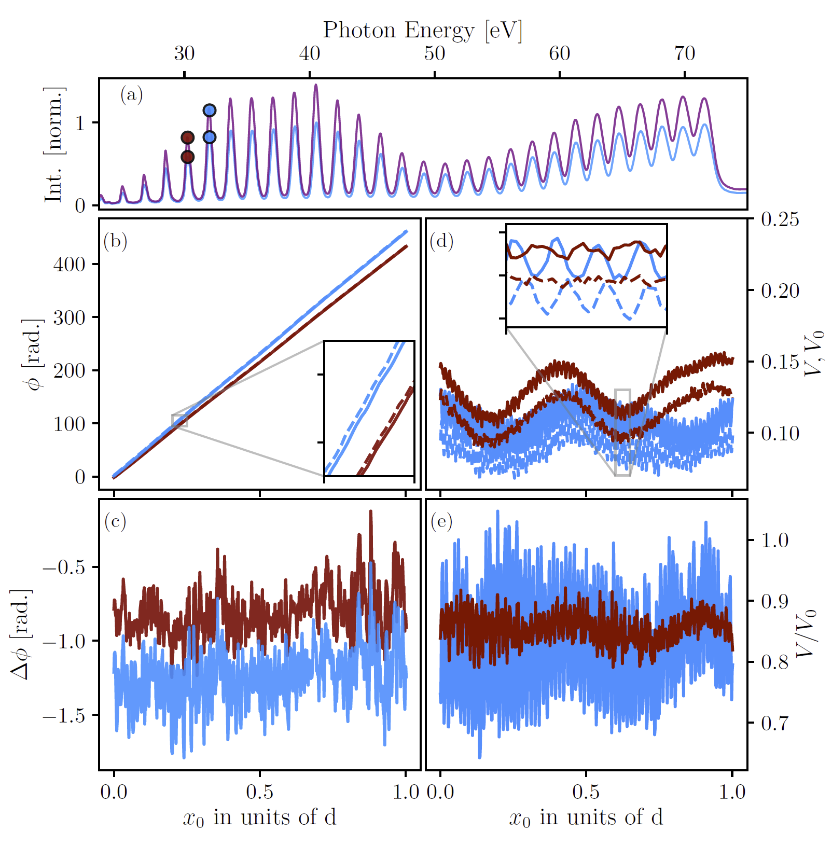

Slide 26
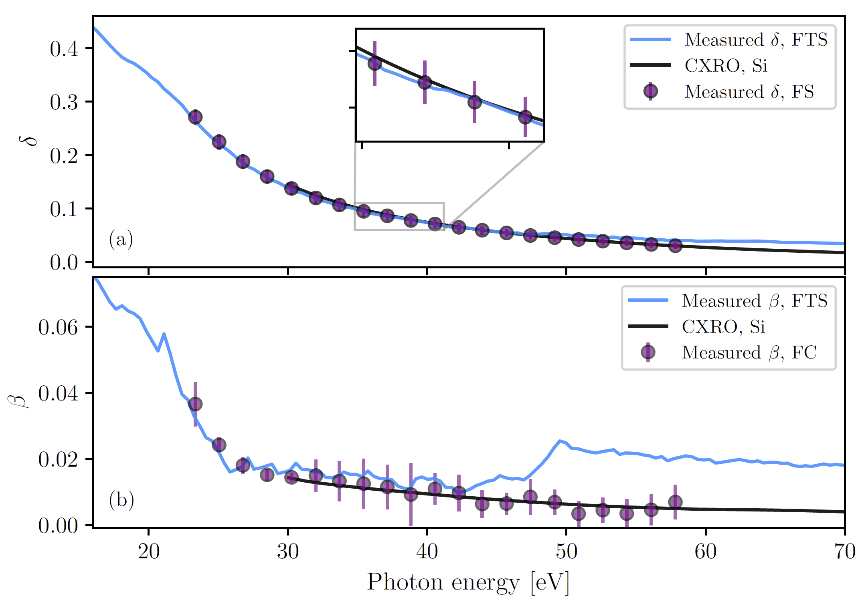


Slide 27



Slide 28


Slide 29




Slide 30




Slide 31


Slide 32



Slide 34





Slide 35



Slide 36


Slide 37


Slide 38


Slide 39





Slide 40





Slide 41



Slide 42


Slide 43




